Slide 1
40 Years in Clinical Research at UCSF: Lessons Learned
Stories about research, teaching and administration
Themes:
Clinical research is on the rise
Career development
It’s the people
Notes:
Lessons Learned: Eternal Verities or merely Internal Varices?
K scholars ask about career development—things have changed, it’s tougher now, but some in this room will succeed beyond their dreams
Older members of the audience—revisit events and transitions
Only a few of my research projects
For younger set—harder now—sorry about that-- but it wasn’t easy then and the same principles apply
For the rest of you…
Hard to cover 40 years—only two of my research projects

Slide 2
What is clinical research?
All health-related research other than basic bench science
Clinical trials and patient-oriented research
Epidemiologic studies
Health services research and the social sciences
Translational research
T1: bench to clinical
T2: clinical to population
Notes:
PURE basic bench science

Slide 3
Antecedents
1923 Oxford
Notes:
Anecdote about no IRB
Photos: Parents at Oxford, me in med school, me in California

Slide 4
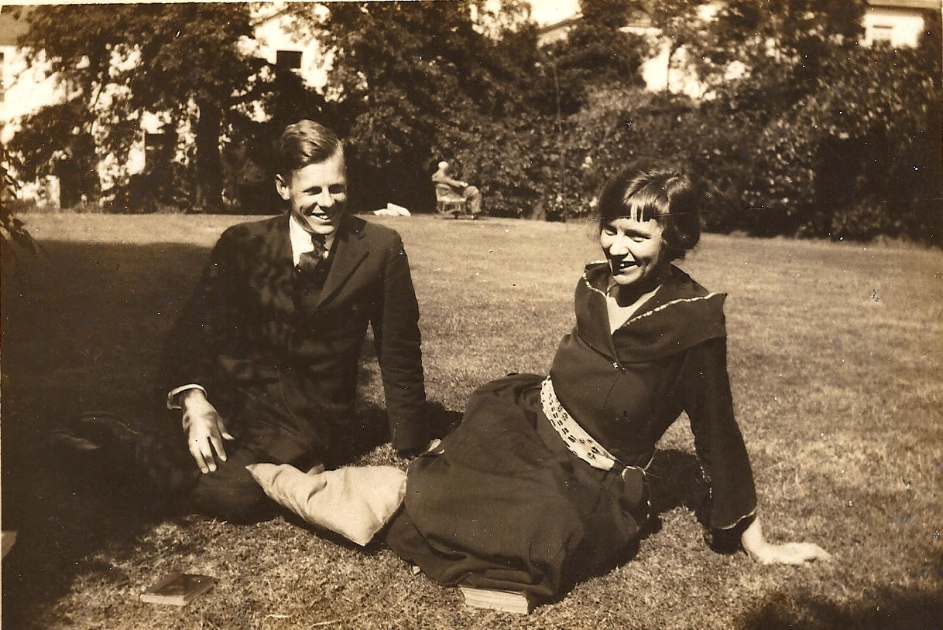

Slide 5
Antecedents
1923 Oxford
1964 MD
1966 Endocrinology fellow
Calcium balance studies on the BCH GCRC
1968 California!
Cardiovascular epidemiologist
Notes:
Anecdote about no IRB: The middle ages
Photos: Parents at Oxford, me in med school, me in California

Slide 6
1968-72 USPHS Hospital in San Francisco Heart Disease and Stroke Control Program
Chief of Lipid Lab/Metabolic Unit
Co-investigator, Japanese-American Study
UCSF Clinical Instructor of Medicine WOS

Slide 7
Lessons Learned
I’ve been lucky
Parents
Vietnam/San Francisco
The small pond option
Can work out well, if it’s the right pond
Notes:
Anecdote about no IRB

Slide 8
1972-82 MRFIT (Multiple Risk Factor Intervention Trial)
Growing epidemic of CHD, no proven prevention (!)
NIH RFP, study designed by an advisory group
RCT of 12,688 high risk middle-aged men in 20 sites
Special intervention (SI) vs Usual Care (UC) for 6 years
Diet counseling/cooking classes for cholesterol
Thiazide/reserpine for high BP
Counseling/group therapy for smoking
Primary outcome: CHD death
Notes:
Why not drug for cholesterol—LRC
(also, no good drug available)
NHLI, NHLBI

Slide 9
MRFIT outcomes
Risk factor outcomes:
Insufficient change in SI group
More than expected change in UC group
Disease outcomes:
Primary outcome: No effect on CHD Death rate
Secondary CHD outcomes: Inconclusive
Notes:
Therefore less delta RF and less power

Slide 10
Lessons Learned from MRFIT
The cardinal crime for an RCT—an inconclusive result—was due to design problems:
Unblinded
3 interventions, 2 involving complex behaviors
No pilot study: Effects of SI and UC on risk factors
Mitigating consequences of failed $100M 10-year study
Delayed and serendipitous contributions to science
A multicenter study can be a great stepping stone
Notes:
Later on there was an effect on CHD death

Slide 11
MRFIT as stepping stone
Opportunity to take the reins
PI of SF clinical site at age 33 (Len Syme and McFate Smith, CO-PI’s)
Chair of MRFIT Lab Committee, then Intervention Committee
Some publications
Lifelong colleagues and friends
Mary Wooley, Leslie Roos
Curt Furberg, Jerry Stamler
Career advancements
1975 MPH at UCB
1976 adjunct associate professor of medicine, UCSF (per Nick Petrakis)
1978 associate professor of medicine, Stanford (per Jack Farquhar)
Notes:
Big fish in a medium sized pond
Just a few publications—not much happened in first 10 years

Slide 12
Teaching

Slide 13
First day at Stanford (July, 1978)
Person at my office door:
“Can you teach clinical research methods?”
Hal Holman, Director of RWJ Clinical Scholars Program
“Yes”
(it was a lie)
Notes:
(it was a lie—but I did have an MPH…)
No book

Slide 14
Teaching at Stanford, 1978-80
Asst Director, RWJ Clinical Scholars Program
Began learning how to foster the careers of young clinical investigators
Bernie Lo and Mark Hlatky
NEJM report: “Epidemiology as a guide to clinical decisions”*
Drummond Rennie
Influenced by McMaster innovations (Sackett, late 1970’s)
“Clinical Epidemiology”
“Evidence-based Medicine”
*Hulley et al. NEJM 1980;302:1383-9
Notes:
Epi is risk factors and prevention in healthy populations
Clin epi is diagnosis, treatment, outcomes in clinical populations

Slide 15
Definitions
Epidemiology
Distribution and determinants of disease in healthy populations
Clinical Epidemiology
Diagnosis, treatment and outcomes in clinical populations
Both have greatly benefited from advances in biostatistics

Slide 16
New Paradigm: Evidence-based medicine Basing practice guidelines on the best available clinical research
Type of evidence
Theory, doctrine, intuition, authority
Personal experience
Epidemiology, Pathophysiology
Randomized blinded trials
Principal concern
Benefits vs harms
Notes:
EBM truly a paradigm shift
Establishing a heirerarchy

Slide 17
Back at UCSF, 1981
Mellon Foundation Clinical Epidemiology Training Programs
Julie Krevans discovered and Phil Lee brokered opportunity to apply
The Mellon grant had few restrictions, no oversight
$600K for 3 years, renewable once
Definition of success: Something useful continuing
Notes:
Like Dan Lowenstein

Slide 18
1982-8 Mellon Clinical Epidemiology Training Program
Modeled on RWJ Clinical Scholars
Mentoring plus weekly seminar (with Winkelstein)
Newman, Browner, Hearst, Feigal, Grady (Cummings, Washington)
Designing Clinical Research course
8 students in 1982 has grown to 280 students in 2010
Tom Newman, Kirsten Bibbins-Domingo, Doug Bauer, others
Secret of success: Each scholar plans her own actual study
1988 Designing Clinical Research text
>100,000 in print
Notes:
DCR seminar gradually attracted others

Slide 19
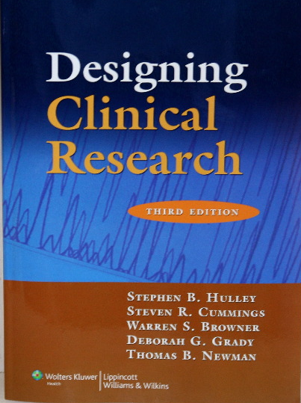

Slide 20
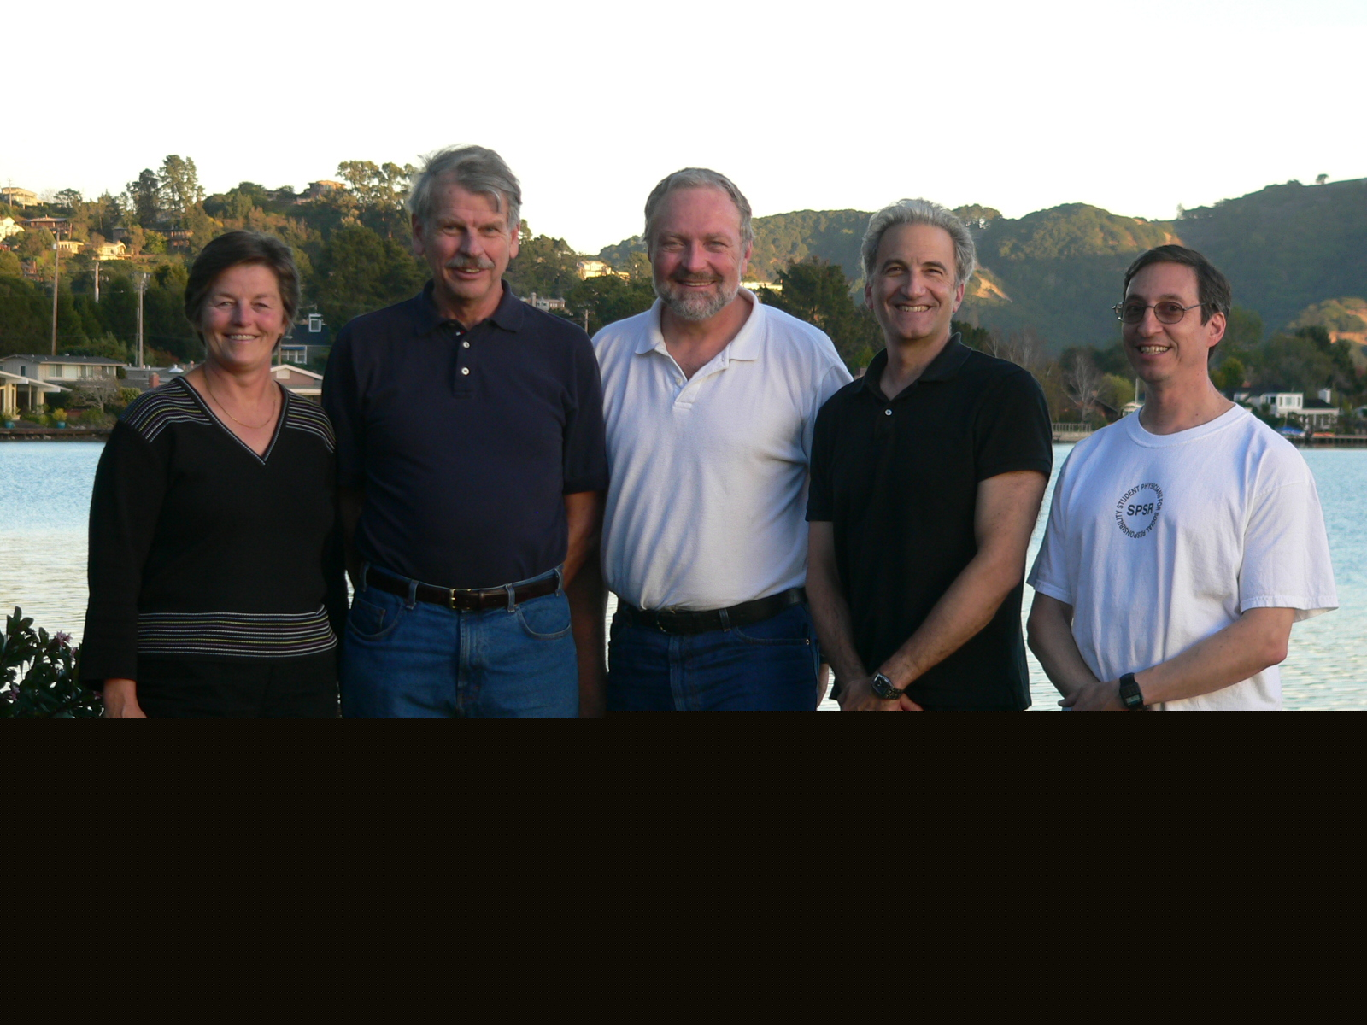
Notes:
All 4 have passed me by

Slide 21
Lessons Learned from RWJ and Mellon
Mentors are helpful in creating opportunities
When opportunity knocks, open the door
Teaching is the lifeblood of academia
Notes:
Two opportunities

Slide 22
Research

Slide 23
CAPS 1986-91
Center for AIDS Prevention Studies (CAPS)
With Coates (Co PI), Sorenson, Fullilove, DuWors
NIMH funding, $2 million/yr
AIDS epidemiology in Rwanda (Allen)*
After 5 years turned it over to Coates
*Allen…Hulley, JAMA 1991;266:1657; JAMA 1992;268:3338

Slide 24
Lessons Learned from CAPS
When opportunity knocks…
Opportunities usually have antecedents
Expertise in clinical epidemiology is broadly useful across all health sciences
But, the rolling stone quandary
Each body of knowledge and set of national colleagues is vast
Good to settle on one major area
Back to cardiovascular clinical epidemiology
Notes:
Chapter in Cecil: Injury epidemiology is the “Sleeping Giant of Preventive Medicine”
Experience at the International AIDS conference in mid to late 80’s
Rolling stone gathers no moss—good or bad
Gave up CAPS, as I have given up several others (MRFIT and CARDIA)

Slide 25
HERS, 1992-2002 (Heart and Estrogen/progestin Replacement Study)
1942 FDA approves Premarin (CEE) for hot flashes
1966 book “Feminine Forever” by RA Wilson MD
“Menopause is a hormone deficiency…totally preventable”
70’s and 80’s evidence that estrogen prevents CHD
Numerous epidemiological and pathophysiological studies
80’s progestin added to prevent estrogen-induced endometrial Ca
1990
Premarin the leading prescription drug, Prempro the fastest growing
Hot tub with Steve Cummings
Notes:
RA Wilson: “In the entire realm of medicine, there are few forms of therapy with a more consistent record of beneficence.
Only problem—not a scientific record

Slide 26
HERS: Ethical? (1992)
Equipoise (uncertainty as to whether benefits or harms predominate)
Benefits of hormone Rx
Reduces menopausal symptoms
Thought almost certainly to prevent CHD
Thought probably to prevent fractures
Thought perhaps to prevent Alzheimer’s Disease
Harms
Possible venous thrombo-embolism
Possible breast cancer

Slide 27
HERS trial (Sponsor: NIH Wyeth-Ayerst)
Colleagues: Grady, Ireland, Vittinghoff, Shepherd, Simon
RCT: Does E+P after menopause prevent heart attacks?
Subjects
2763 women at 20 sites
postmenopausal with a uterus; age < 80 (mean age = 67)
documented coronary disease
Predictor
Premarin+MPA vs blinded placebo
Outcome
4-year rate of MI or CHD death

Slide 28
MI/CHD death in HERS: Early harm and later benefit?
Primary CHD events
Year E + P Placebo RH 95% CI
1 57 38 1.5 1.0-2.3
2 47 49 1.0 0.7-1.5
3 35 42 0.8 0.5-1.3
4 + 5 40 53 0.7 0.5-1.1
P for trend = 0.03
Hulley, Vittinghoff, Grady et al JAMA 1998;280:605-13

Slide 29
Venous Thromboembolic Events
Treatment Group
E + P
Placebo
RH
P - value
DVT/PE 34 13 2.7 0.003
Deep vein thrombosis 25 9 2.8 0.008 Pulmonary embolism 11 4 2.8 0.08
Grady…Hulley. Ann Intern Med 2000;132:689

Slide 30
Reaction to HERS, 1998-2001
Conclusion: no CHD benefit; thromboembolism harm
Clinicians, NYT: “Something’s wrong, we don’t believe it”
Researchers: 1998 JAMA report* the most cited article in the medical literature for many months
Lancet editorial re HERS**: “There are occasions when a single study causes a sea change in medical practice”
* Hulley et al, JAMA 1998; 280:605-13
**Editorial, Lancet: 2001; 358:1196

Slide 31
Annual US Prescriptions for Hormone Therapy
HERS
WHI
Hersh, JAMA 2004;291:47

Slide 32
Disease outcomes in HERS (1998) and WHI (2002)
RH (95% CI)__
Outcome HERS E+P WHI E+P
(N = 2763) (N = 16,608)
MI+CHD death 1.0 (0.8-1.2) 1.3 (1.0-1.6)
Stroke 1.2 (0.9-1.7) 1.4 (1.1-1.8)
Pulm Embolism 2.1 (1.3-3.4) 2.1 (1.6-2.8)
Breast cancer 1.3 (0.8-1.9) 1.3 (1.0-1.6)
Hip fracture 1.1 (0.5-2.5) 0.7 (0.5-1.0)
Dementia* 2.0 (1.2-3.5)
Hulley & Grady, JAMA 2004;291:1769 (editorial)
*Schumaker, JAMA 2004;291:2947

Slide 33
HERS: Ethical? (1992)
Equipoise (uncertainty as to whether benefits or harms predominate)
Benefits of hormone Rx
Reduces menopausal symptoms
Thought almost certainly to prevent CHD
Thought probably to prevent fractures
Thought pernaps to prevent Alzheimer’s Disease
Harms
Possible venous thrombo-embolism
Possible breast cancer

Slide 34
HERS: Ethical! (2002)
Equipoise removed for this E+P and patient population
Benefits of hormone Rx
Reduces menopausal symptoms
Prevents fractures
Harms
Causes heart attacks
Causes strokes
Causes venous thrombo-embolism
Causes breast cancer
Worsens cognitive function

Slide 35
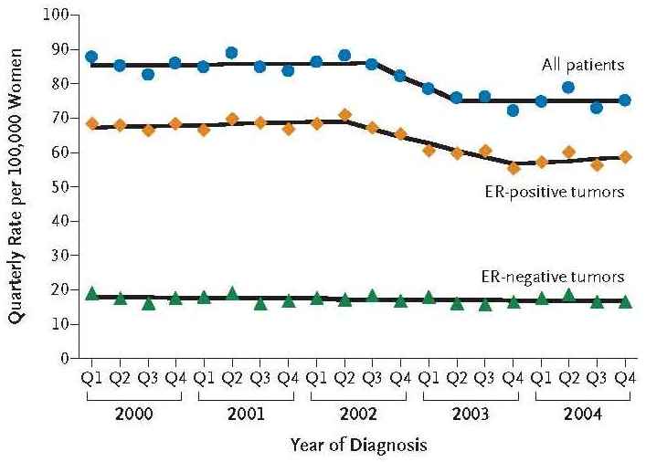
US breast cancer incidence, SEER registries
Ravdin, NEJM 2007;356:1670-4

Slide 36
Lessons Learned from HERS
Practice guidelines on post-menopausal hormones:
Can use short-term for severe menopausal symptoms
Do not use for preventing CHD, stroke, dementia
Clinical trials trump epidemiology/pathophysiology, which sometimes get the wrong answer
EBM rocks!
Notes:
Clinical epi is the basic science of EBM

Slide 37
Health Policy

Slide 38
NCEP ATP I* (1988) and ATP II** (1993)
Chaired Epidemiology Subcommittee (under Grundy)
Promoted EBM culture in the committee
Abandoned “lipoprotein phenotyping”
Treating top 5% of LDL-cholesterol and TG
* NCEP Expert Panel, Arch Int Med 1988;148:36-69
**NCEP Expert Panel, JAMA 1993;269:3015-23

Slide 39
Serendipitous MRFIT outcomes (361,662 screenees)
Martin MJ, Hulley, et al. Lancet 1986;2:943
Notes:
Comment on J curve

Slide 40
NCEP ATP I* (1988) and ATP II** (1993)
Chaired Epidemiology Subcommittee (under Grundy)
Promoted EBM culture in the committee
Abandoned “lipoprotein phenotyping”
Treating top 5% of LDL-cholesterol and TG
Brought HDL to the foreground
Popularized statins
Introduced risk-specific cutpoints for intervention
* NCEP Expert Panel, Arch Int Med 1988;148:36-69
**NCEP Expert Panel, JAMA 1993;269:3015-23

Slide 41
Administration
Department Chair, Epidemiology and Biostatistics 1994-2006
Thanks to Haile Debas

Slide 42
Accomplishments as Chair
Emphasized teaching clinical epidemiology:
Medical student curriculum in epidemiology (Ernster, Jackson, Gonzales, Chan) and biostatistics (McCulloch)
Fellow/Faculty Training In Clinical Research (TICR) (Martin)
Grew faculty: Newman, Grady, Rutherford, Hiatt, Pletcher, Witte, Vittinghoff, Glidden, Boscardin, Neuhaus, Cummings, Lo, Bibbins-Domingo, Sawaya, Brown, Whooley, Desmond-Hellman,…
Grew research: Doubled to $20M/year
Led staff: Mead, Lopez, Fox, Armour, Babcock, Yuen, DeLeon, Deneen…
Improved finances:
Distributed 19900 funds among teachers
increased indirect cost return; improved administrative efficiency
Notes:
Remained upbeat, vigorous supporter of Chair Ernster
Desmond-Hellman

Slide 43
Failings as Chair
Space negotiations
Fund-raising
Schmoozing
Notes:
Remained upbeat, vigorous supporter of Chair Ernster
Add Sally

Slide 44
Lessons Learned as Department Chair
Administration gets a bum rap
Paperwork and committees: can be tedious
Responsibilities/decisions: can wear you down
Perfection: unattainable
However…
Opportunity to lead the direction things go in
To improve the lives of those in your department and beyond
A privilege that can be extremely gratifying

Slide 45
Teaching

Slide 46
Macrocosm: NIH and clinical research training
Nathan report, Varmus
Early 90’s decline in number of MD PI’s, need for clinical researchers
Mid 90’s individual K awards for junior faculty (N~5000)
Late 90’s K30 Curriculum-development awards for institutions (N~60)
1998-2003: Doubling of the NIH budget
NIH Roadmap
2003 Roadmap goal to promote T1 and T2 translational science
2004-5 Roadmap KL2 and TL2 training/career development
2006-10 CTSAs (Clinical and Translational Science Awards)
“an academic home for clinical and translational science” that combines training awards, GCRC’s, infrastructure, cost sharing (55 institutions)

Slide 47
Macrocosm: AAMC chimes in
2006 Clinical Research Task Force II
1. All medical students to be trained in clinical research
2. Regulatory bodies for medical schools and residency programs to add clinical research methods to core competencies
3. Clinical investigators to have master’s degree
4. New clinical research faculty to have 3 years protected time
8. Med schools to improve clinical research infrastructure
12. AMC’s and med schools to accord higher stature to clinical research

Slide 48
UCSF: Training in Clinical Research (TICR) Newman, Grady, Lo, Whooley, McCulloch, Glidden, Vittinghoff, Gonzales, Pletcher, Bibbins-Domingo, Ireland, others
1982 Designing Clinical Research
Self-sustaining business model
1992 Full curriculum of courses, 1-yr Certificate (Martin)
1999 NIH K30: $200K/yr to administer training program
2002 2-yr Master of Clinical Research (Martin)
Advantage over MPH: Experiences and products of clinical research
2004 Roadmap KL2 Career Development for faculty (Hulley; #1)
2005 Roadmap TL2 ditto for students (Palefsky; #1)
2006 CTSI (McCune, Grady, Palefsky, Lowenstein, Johnston; #2)
Training components, led by Grady, comprise all of the above
Notes:
Replace with table

Slide 49
CTSI K Program
25 KL2 awards for junior faculty from across the campus
Training and career development
Master of Clinical Research degree
75% protected time for research: $75K salary, 4-5 years
Multidisciplinary infrastructure
weekly work-in-progress support groups
long-term mentoring, core experts, access to data sets
$25K/year for research
Career goal: become a leading force in clinical/translational research
“K Program”: 35 additional junior faculty with K23’s, K01’s etc.

Slide 50
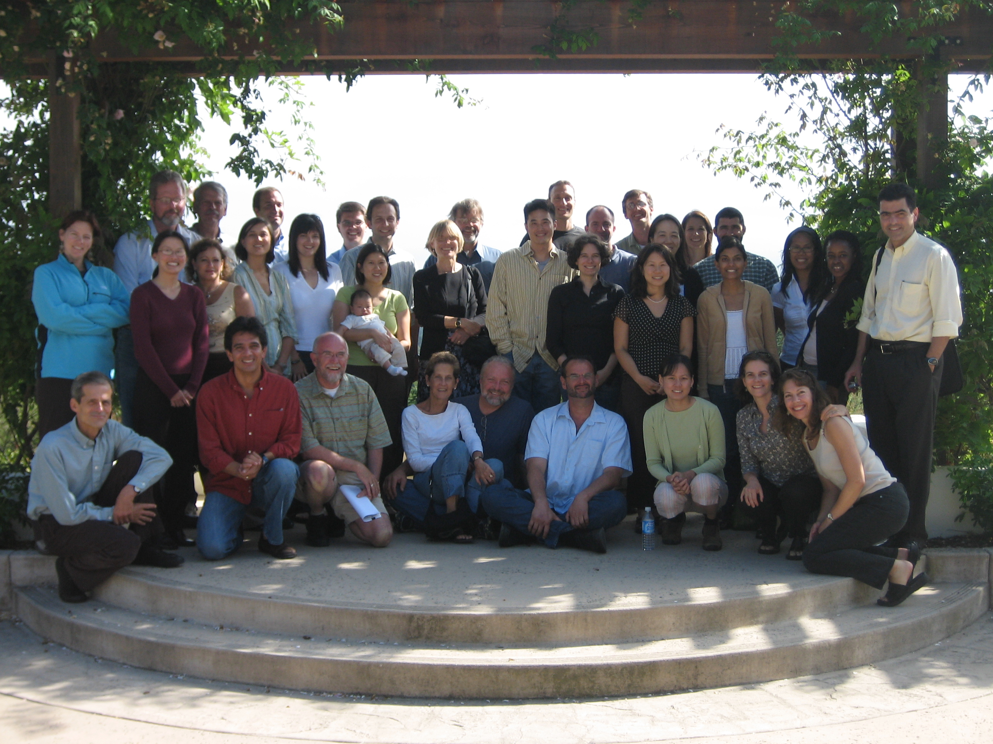
Notes:
Where’s Hulley
All faculty

Slide 51
Challenges and solutions
Clinical research careers increasingly challenging
More and more better-trained young clinical investigators
Funding increasingly difficult
Solutions
Mentors essential to provide a hand up, and continue in that role
Partially funded institutional setting as a base
Tenacity, networking, and writing skills
UCSF is full of select people who will make it happen!
First two cohorts of KL2 faculty scholars:
6/14 are PI of R01 or equivalent
8/14 are PI of K23 or equivalent
6/14 have been recruited to top tier jobs elsewhere
Notes:
Role of DCR in becoming tenured, Department Chair
Role of mentors in my career, role of protegees
Denominator is growing rapidly, but numerator is also growing
Mass General, Pitt, U Virginia, U Wisconsin, BU, Stanford
13/14 have one of the above

Slide 52
Lessons Learned: Career Development
Clinical research training is a rising star
Nationally NIH, AAMC and CTSA’s at 55 academic institutions
UCSF in the vanguard, but needs to keep moving

Slide 53
Three Components of Clinical Research
Research:
Coin of the realm for academic careers
Practice guidelines based on EBM is marvelous new paradigm
Has led to huge improvements in health care over past 40 years
Administration:
Looking beyond the tedium and tough decisions, important and rewarding
Teaching:
Love the culture of medical academia: everyone both teacher and student, often daily and beyond the call of duty—for the sheer love and interest
Multiplier effect that keeps on growing
Lifeblood of academia
Notes:
I have never written a single author report
More difficult now
Lots accomplished but 40 years is a long time
And the reason I got to receive this award
Administration gets a bum rap
I love the culture of medical academia

Slide 54
It’s the people
Mentors | Colleagues | Protegees | Staff
Milt Nichaman | Curt Furberg | Bernie Lo | Mary Woolley
Len Syme | Larry Freidman | Mark Hlatky | Leslie Roos
Mack Smith | Tom Coates | Tom Newman | Chris Ireland
Jerry Stamler | Jim Sorenson | Warren Browner | Cary Fox
Nick Petrakis | Mindy Fullilove | Norman Hearst | Georgina Lopez
Jack Farquhar | Eric Vittinghoff | Deborah Grady | Peter Armour
Hal Holman | Rodger Shepherd | Steve Cummings | Phillip Babcock
Julie Krevans | Virginia Ernster | Gene Washington | Sally Mead
Phil Lee | Chuck McCulloch | Mindy Fullilove | David Swanson
Warren Winkelstein | George Rutherford | Susan Allen | Clark Seeley
Scott Grundy | Sue Desmond-Hellman | Joel Simon | Chris Choy
Haile Debas | John Witte | Jeff Martin | Olivia DeLeon
 | Eric Vittinghoff | Mark Pletcher | Shirley Yuen
 | David Glidden | Mary Whooley | Allison Deneen
 | Ralph Gonzales | George Sawaya
 | Kirsten Bibbins-D | ~70 K Scholars
 | Jeanette Brown
 | John Boscardin
 | John Neuhaus

Slide 55
Thanks to
Linda Hulley
Kara Bischoff MD
Ben Hulley MD
George Hulley UCSF 4th year med
Notes:
All three have already surpassed me, age for age

Slide 56
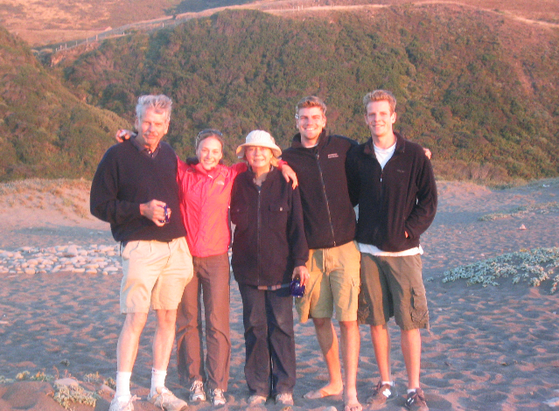

Slide 57
Thanks also to
Tom Newman and all my friends
UCSF
Notes:
All three have already surpassed me, age for age

Slide 58
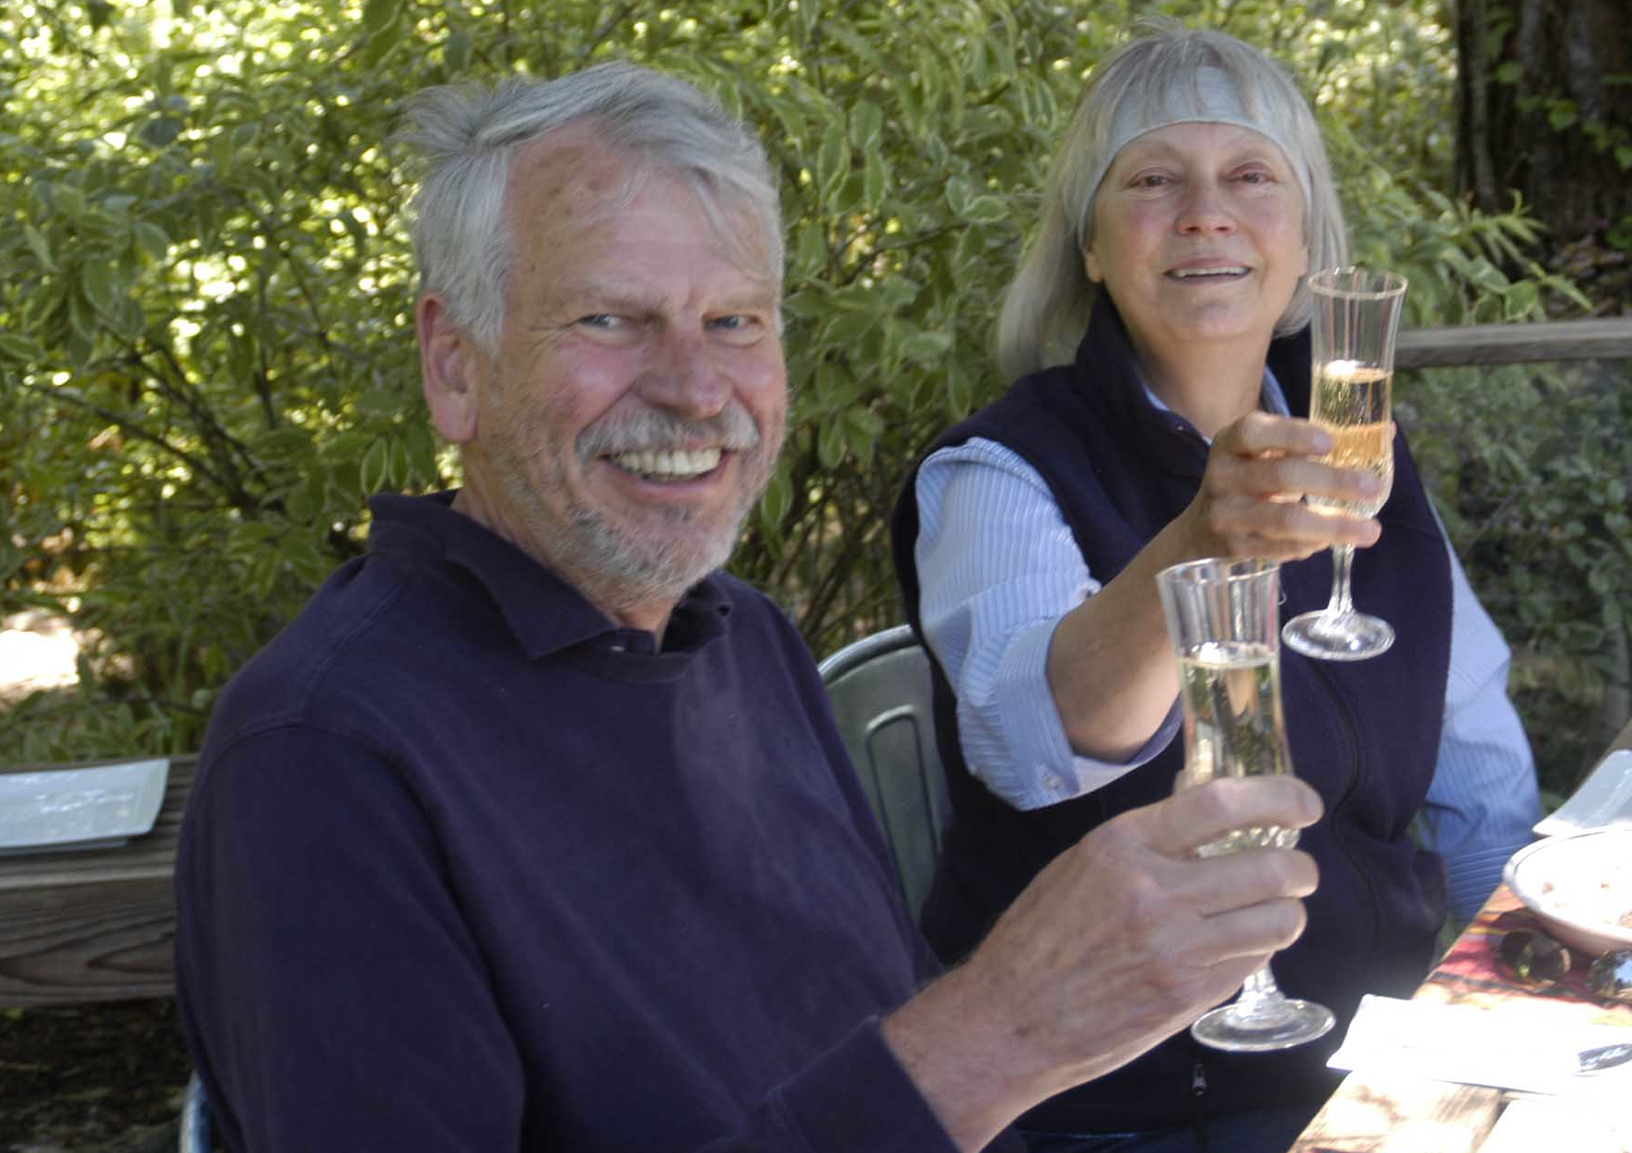
Notes:
Picture of us in Orcas

