Slide 1
Campaign Planning Update Academic Senate, January 24, 2017
John B. Ford, Vice Chancellor
University Development and Alumni Relations

Slide 2
Campaign Planning Objectives
Working with leadership, faculty, and volunteers, identify 3-6 cross-cutting themes
Design gift opportunities aligned with themes:
Continue to raise support for students, trainees, faculty, and programs
New program support
Endowment
Buildings and equipment
Campaign is additive: “and” and not “instead of”
Academic Senate 1/24/2017

Slide 3
Campaign Planning Process
Faculty outreach
Six meetings with deans, chairs, and directors
183 ideas submitted
Content development
Synthesized into six working themes
Further refined by faculty in working groups
Academic Senate 1/24/2017

Slide 4
Campaign Planning Process and Approval
Volunteer engagement
Four meetings with board members and others
Preparation for December 8 Board meeting
Senior Leadership and Board Approval
Chancellor recommended proceeding
Board of Overseers voted unanimous support
Academic Senate 1/24/2017

Slide 5
Monetary Goal
Target goal: $5 billion
Target public launch: Fall 2017
Target end date: 12/31/20 (will not be publicly announced)
Campaign nucleus fund = all new commitments beginning 7/1/13
Quiet phase of four years+

Slide 6
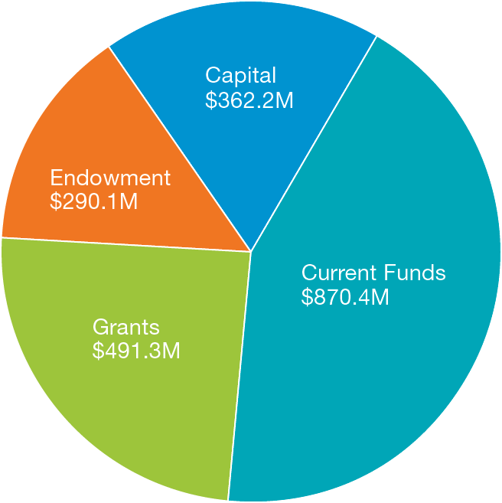
Campaign Nucleus Fund
FY14-16: $2.01B
FY14: $580.4M
FY15: $686.4M
FY16: $747.1M

Slide 7
Non-Monetary Goals
Catalyze planning; set university priorities
Raise the visibility of UCSF
Expand base of donors and volunteers
Identify next generation of volunteer leaders

Slide 8
Next Steps: Refining Content
Language and presentation
Tell a compelling story
Highlight UCSF’s differentiators
Present fewer themes
Organization of ideas: Matrix
Cross-cutting themes
Disease areas
Mission pillars

Slide 9
Next Steps: Planning
Recruit campaign leadership
Adjust campaign goals
Collect and refine content up until public launch in Fall 2017
Prepare campaign materials
Engage key prospects
Continue to build the nucleus fund
Academic Senate 1/24/2017

