Slide 1
Open Plan Workspace Change Management
Design Team Recommendations
Presentation to Academic Planning & Budget Committee
Cristina Morrison & Kevin H. Souza
June 20, 2017

Slide 2
Topics
Context
Design Team Formation
Open Plan Adoption Framework
Specific Recommendations
Appendix: Detailed Report

Slide 3
Context
Approximately 1,700 people are currently working in Open Plan Workspaces
By the end of 2019, this number will increase to approximately 4,000 people working in Open Plan Workspaces, which is approximately 20% of the UCSF campus workforce.
Based on lessons learned, we need to:
engage early with building occupants
acknowledge the changes that come with open plan workspace and proactively address them
develop a change management plan to ensure a smooth transition
Notes:
Campus employees (not including UCSF Health) =approx 19,953
20% of the campus workforce

Slide 4
Design Team Formation
In October 2016, Executive Co-Sponsors Dan Lowenstein and Paul Jenny reached out to faculty and staff leaders to request participation on the Open Plan Change Management Design Team.
A total of 9 Design Team members elected to participate in the process.
To support the Design Team’s work, a Project Management Team was formed with membership from Campus Planning, School of Medicine Dean’s Office and Project Management Office (PMO)

Slide 5
Design Team & Project Team Members
Georgina Lopez, Administrative and Finance Manager, Global Health Sciences
Kevin H. Souza, Associate Dean, Medical Education, School of Medicine
Christine Razler, Director of Research Administration, Department of Medicine
Mike Billings, Managing Editor, University Relations
Adam Schnirel, Facilities Services
Jon Rueter, Division Manager, Division of General Internal Medicine
Suzanne Murphy, Executive Director, EVCP & FA.
Sharat Israni, Executive Director, Institute for Computational Health Sciences
Angela Rizk-Jackson, Director of Operations, ICHS
Project Team:
Cristina Morrison, Cara Fladd, Karin Wong, Mara Fellouris, Jill Goldsmith

Slide 6
Open Plan Adoption Framework Enabling our People to Thrive
Working/Living in the Building
Building Governance Structure and Roles
Shared Services
Shared Costs Funding Model
Transition and Community Building
Notes:
This will be a talking point: UCSF should establish policies, practices and structures that minimize time spent on minor items that can cause a lot of grief, thereby enabling staff and faculty time to focus on their work.
Approach for slide is to speak to the findings here, thus introducing the components. Then slides with the recommendations.

Slide 7
Working/Living in the Building Recommendations
Working/Living in the Building
Governance Structure and Roles
Shared Services
Shared Costs Funding Model
Transition and Community Building
Support Getting Around: Reception areas and clear wayfinding
Provide Adequate Equipment and Tools: Appropriate tools for mobile working
Adopt Behaviors and Norms: deploy guidelines for standard etiquette in Open Plan buildings that building governance groups can tailor to their needs.
Creating/Preserving Identity: Promote the idea of “One UCSF” while enabling departments to their maintain department identity
Open Plan Workspace Change Management
Notes:
The talking points can speak to selected details of what we designed etc.
Recommend useful, consistent signage and wayfinding throughout the building.
Recommend a reception/welcome area on each floor with a phone and electronic directory close to the elevator/reception area.
Each occupant needs a laptop, monitor and keyboard to work effectively, with the ability to plug and play in meeting rooms. Department should provide these.
An enterprise available document management software is needed to support Departments’ transition to electronic files.
Huddle and conference rooms required adequate AV technology that is easy to use and follow common standards.

Slide 8
Open Plan Governance Structure and Roles Recommendations
Working/Living in the Building
Governance Structure and Roles
Shared Services
Shared Costs Funding Model
Transition and Community Building
Open plan necessitates occupant-driven governance of the space given the multi-departmental character of the occupants
Design Team recommends two levels of governance: Building wide and Block level (1 or more floors)
Open Plan governance is not intended to substitute for management responsibilities: Department management remains accountable for department personnel
Create new role of Space and Operations Coordinator already in practice at Mission Hall and critical to smooth operations of future Open Plan buildings
Notes:
From Mission Hall, we learned that Open Plan requires occupant driven governance. We have the opportunity to set this up on the front end, instead of being reactive.
Building wide:
Development of general principles
Common use of building
Single point of contact for service provider and approval of Service Level Agreements
Block level:
Adaptation of building principles
A vehicle for decision-making across multiple units/orgs
Block leaders need to be engaged and empowered
Space and operations coordinator
Responsible for:
Working with building occupants on how to work within an open plan workspace environment
Assisting in verifying and documenting space assignments and analyzing space utilization
Liaison to governance committees
Funded for three years for one person for Block 33 and Mission Hall
Need funding for CSB and other future buildings

Slide 9
New Shared Services Recommendations
Working/Living in the Building
Governance Structure and Roles
Shared Services
Shared Costs Funding Model
Transition and Community Building
Enhance Facilities Services to meet new minimum standards: cleanliness and sanitation, pest and insect control, and basic convenience services; incorporate costs in annual facilities budget
Provide assigned accountability to manage the huddle and conference rooms : maintenance, standard technology and support, how to documentation, and clear “how to call” information. Any solution requires funding.
Provide coffee/tea and equipment: small cost with large positive impact on UCSF’s goal of Great People, Great Place
Funding model for shared services: recommend these guiding principles: (1) Efficient funds flow; (2) Cost neutral for majority of departments in Open Plan; (3) Equitable cost sharing; (4) Supports Great People-Great Place initiative
Notes:
facilities
Services that address cleanliness and sanitation conditions: full-time day porter services to address restroom, kitchen, and common area cleanliness
Services that prevent and address pest/insect control: increased carpet cleaning; increased trash, recycling and compost services
Services that provide efficiency and convenience for the customers (reduces unnecessary recharge transactions with limited value): maintenance/replacement /disposal of commercial refrigerators, microwaves, and water purifiers
On conference rooms: Multiple campus groups are discussing how to best work together to provide a proposal that coordinates all huddle/conference room support into a one-stop shop for our staff and faculty.
Coffee:
Lining up coffee pots on kitchen counters is not a viable option – can’t put locks on pots
Providing coffee/tea is a way of showing respect for employees
The transparency of the Open Plan environment brings up the issue of providing coffee/tea to employees. Approximately 50% of departments moving into Block 33 and CSB currently provide coffee/tea free of charge to their employees.
Recommend that the Campus provide hot and cold filtered water and coffee machines for all Open Plan floors.
In addition, recommend that the campus provide and pay for coffee/tea for all people in open plan building.
Reasons to Provide Coffee/Tea Service
Would help with employee engagement, recruitment and retention of employees, and contributes to the “Great People – Great Place” initiative
Would eliminate hazard of employees having individual coffee makers at their desks
For staff and faculty who currently have coffee/tea provided, not having it would be an unwelcome change and could contribute to bad morale and/or feelings of loss

Slide 10
Transition and Community Building Recommendations
Working/Living in the Building
Governance Structure and Roles
Shared Services
Shared Costs Funding Model
Transition and Community Building
Consistently engage with over 60 Change Agents and prepare them for moving and transition to Open Plan environment. Change agent list will be available on Open Plan Design web page in Fall 2017.
Establish governance structures before moving into the building in order to work through building protocols and processes
Provide transition tools and events
File Shredding parties
Welcome packets
On-line user guides
Website with all relevant information
Hold Community Building events before and after move-in.
Notes:
Ctty Building: Open House at new building prior to move in, showcasing how to print, how to use focus rooms, kitchens etc

Slide 11
Implementation Timeline
Work needs to begin now on standard open plan change items including technology, shared services requirement details and funding model.
New open plan building governance should be in place at least 6 months before move in and support provided to address the building specific change management tasks included in the detailed implementation plan.
Open Plan Workspace Change Management

Slide 12
Discussion

Slide 13
Appendix: Detailed Report
Project Goals
Approach to Design the Change Plan
Issues in Open Plan today
Change Management Design Project Structure
Shared Services Necessitated by Open Plan
Implementation Timeline
Staffing Functions needed for Implementation
Open Plan Workspace Change Management

Slide 14
Project Goals
Develop a change management plan for Open Plan Workspaces that will enable a smooth transition into new Open Plan Workspace buildings
Change Management Plan includes these components:
Building Governance and Management
Space Assignment Strategies
Equipment and Tools
Behaviors and Norms
Department Identity
Community Building
Implementation plan
Engage with building occupants early and use CSB and Block 33 to road test the recommendations
Open Plan Workspace Change Management
Notes:
Learned many lessons at Mission Hall and want to engage with building occupants early

Slide 15
Approach Used to Design the Change Plan
Established a Design Team comprised of current and future open plan occupants and service providers
Established a Change Agent group of prospective new open plan building occupants to begin early engagement
Held design team workshops and conducted gemba to formulate recommendations
Identified customer values and based recommendations on those values
Validated recommendations with Change Agents and service providers
Notes:
Design Team comprised of current and future open plan occupants as well as service providers
Change Agents representing departments moving into CSB and Block 33
Conducted 4 full day design sessions with the Design Team
Focused first on who the customers of the change management plan are and what they value
Went to “gemba” by observing in Mission Hall
Developed a set of recommendations, along with an implementation plan
Conducted two Town Halls with Change Agents to review the recommendations and obtain feedback
Met with Service Providers (ETS, ITS, Campus Planning, Capital Programs and Facilities) to discuss the recommendations affecting their services.

Slide 16
Project Structure
Executive Sponsors
Dan Lowenstein, Paul Jenny
Provide funding and advocacy
Wear a “campus hat” to develop strategies and recommendations to facilitate the occupant and department transition to flexible open plan environments.
Design Team
Change Agents
Obtain Feedback
Provide Feedback
Serve as Champions of Change for Department
Guide the execution of the work
Coordinate efforts and ensure quality deliverables.
Project Management Team
Cristina Morrison, Cara Fladd, Karin Wong, Jill Goldsmith and Mara Fellouris
Open Plan Workspace Change Management

Slide 17
Issues in Open Plan Today
The “openness” of Open Plan requires units on the same floor to share items they have not previously shared in traditional office environments, such as office equipment, kitchen equipment, conference and huddle rooms, and common areas such as walkways, storage, mail and reception areas.
Accountability, responsibility and processes for managing and paying for these common tools and services is unclear, and thus where many of the problems in Open Plan arise.
Difficulties in locating individuals and meeting rooms, the lack of privacy and noise carrying farther in Open Plan environments can affect staff and faculty productivity.
Occupants feel that personal and department identity can get muddled and it can be hard to locate people.

Slide 18
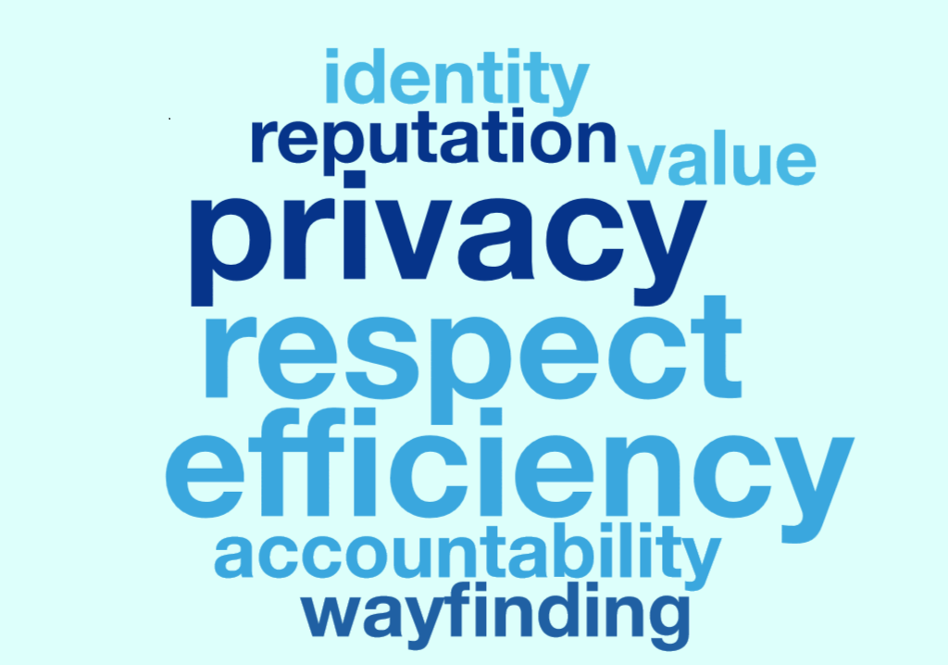
What Open Plan Occupants Value
Notes:
Identified several customer groups and these are the values they share

Slide 19
Shared Services Necessitated by Open Plan
Open Plan Workspace Change Management

Slide 20
Open Plan Requires Enhanced Facilities Services
Working/Living in the Building
Governance Structure and Roles
Shared Services
Shared Costs Funding Model
Transition and Community Building
We now know that open plan work space buildings by their very nature require increased levels of facilities services. These services can be grouped into three buckets, which represent new costs above what has traditionally been provided by Facilities Services.
Services that prevent and address pest/insect control: increased carpet cleaning; increased trash, recycling and compost services
Services that address cleanliness and sanitation conditions: full-time day porter services to address restroom, kitchen, and common area cleanliness
Services that provide efficiency and convenience for the customers (reduces unnecessary recharge transactions with limited value): maintenance/replacement /disposal of commercial refrigerators, microwaves, and water purifiers
Notes:
When the facilities operations and maintenance funding model was established for Mission Hall, UCSF had no experience in what would be expected to fund an open space work plan type of office building. Some of the impacts of this are:
Facilities funding was allocated on the “old” cost per square foot model (using past costs for similarly sized buildings)
Facilities anticipated offering the same services it was used to providing in traditional UCSF buildings
After Mission Hall opened, it became obvious that the old funding model and the old services would need to be reexamined
The high traffic and population density of open plan buildings requires increased customer services to be successful
Customers have expressed dissatisfaction when they are asked to pay for these “new” costs for enhanced service levels

Slide 21
Huddle/Conference Room Support
Working/Living in the Building
Governance Structure and Roles
Shared Services
Shared Costs Funding Model
Transition and Community Building
Recommend that one group provide support and maintenance of huddle and conference rooms to ensure consistency and reduce confusion.
Multiple campus groups are discussing how to best work together to provide a proposal that coordinates all huddle/conference room support into a one-stop shop for our staff and faculty.
Any solution requires funding.
Notes:
When Mission Hall opened, it was unclear who managed the furnishings and technology in the huddle and conference rooms, resulting in a lot of back and forth when the technology did not work or maintenance was required.

Slide 22
Coffee/Tea Service
Working/Living in the Building
Governance Structure and Roles
Shared Services
Shared Costs Funding Model
Transition and Community Building
The transparency of the Open Plan environment brings up the issue of providing coffee/tea to employees. Approximately 50% of departments moving into Block 33 and CSB currently provide coffee/tea free of charge to their employees.
Recommend that the Campus provide hot and cold filtered water and coffee machines for all Open Plan floors.
In addition, recommend that the campus provide and pay for coffee/tea for all people in open plan building.
Reasons to Provide Coffee/Tea Service
Would help with employee engagement, recruitment and retention of employees, and contributes to the “Great People – Great Place” initiative
Would eliminate hazard of employees having individual coffee makers at their desks
For staff and faculty who currently have coffee/tea provided, not having it would be an unwelcome change and could contribute to bad morale and/or feelings of loss
Open Plan Workspace Change Management
Notes:
Lining up coffee pots on kitchen counters is not a viable option – can’t put locks on pots
Providing coffee/tea is a way of showing respect for employees

Slide 23
Staffing Functions Needed to Implement Change Management Plan
Project Management
Communications
Finance Analysis
General Analysis/Administration
Open Plan Workspace Change Management
Notes:
Project Management
Governance structure set up and facilitation
Manage engagement of change agents
Liaison to Building Stakeholder Ctte
Update to Design Team on a periodic basis
General Analysis
Scheduling and tracking meetings
Coordination with service providers (such as ETS, CLS and Facilities) to ensure readiness

