Slide 1
Faculty Welfare Committee
UCSF RISK MANAGEMENT and INSURANCE SERVICES
Prevention is Primary
Bruce G. Flynn, Director
February 9, 2017
Notes:
EV – background
BGF
Began working at UCSF, 1980 – became Manager, Employee Rehabilitation, 1986
Managed HR/Benefits at Wells Fargo Bank, 1992 – 95
UCSF, 1995-97 – managed UCSF/Stanford WC merger as Manager, Disability Management
Washington, DC, 1998-2004 – risk and HR benefits consulting
UCSF, 3/05 – returned as interim director, Risk Management

Slide 2
Mission
The mission of UCSF Risk Management and Insurance Services is to protect the assets and interests of UCSF employees and programs through assessment of loss exposures, focused prevention efforts, and efficient management of insurance and self-insurance programs.

Slide 3
Risk Management Overview
UC self-insured Auto, Employment Practices, General, and Property Liability claims programs
Clinical Research Risk Management – devoted to preventing and/or reducing clinical trial-related human subject injuries; includes clinical trials coverage overseas
University Controlled Insurance Program – management of multiple insurance plans for Mission Bay/Medical Center and Campus construction-related risk
Be Smart About Safety – funds risk mitigation projects for diverse programs such as training for research phlebotomists; ergonomics services; network security; and the Chancellor’s Wellness program.
Travel Insurance – during 2015-16, UCSF faculty, staff, and students registered over 6000 domestic and overseas trips with coverage under the Travel Accident program; iJet system responded to 11 emergency calls and transported 3 faculty/staff back to US
Through these programs, UCSF saved over $1 million of potential risk-related costs in FY16

Slide 4
Travel Data – UCSF faculty, staff and students

Slide 5
Travel Destinations

Slide 6
Overview of UC Travel Program
Travel Insurance
Risk Management Services
Technology
Blanket coverage for faculty, students, regents, other college participants and traveling companions:
Custom location risk assessments for international campus and study abroad locations
Incident management team support and briefs during crisis events (Cairo, Japan, Haiti)
On the ground security assistance in the event of a potentially life-threatening situation while traveling
Emergency Medical Services including medical referrals, payments, emergency transportation, evacuation or repatriation
Emergency Travel Services
Trip Information Services
Dedicated UC Travel Risk Hotline
Crisis hotline and security assistance center to secure immediate assistance while traveling
A secure, web-based system for tracking global threats, accessing location based risk intelligence and other travel related information
Automated security alerts for travelers
24-Hour Business Travel Accident Protection
Global Medical Expense Benefits while traveling outside the U.S.
Travel-related non-medical benefits including Lost Baggage, Personal Property, Trip Cancellation and Trip Delay Benefits.

Slide 7
Business Travel Insurance (Chubb)
Who’s eligible for coverage under the Business Travel Plan?
  All employees, administration, traveling companions & professors emeritus.
  While traveling on business for UC.
  Coverage begins at the start of the trip and ends upon return to home or work. Includes personal deviations.

Slide 8
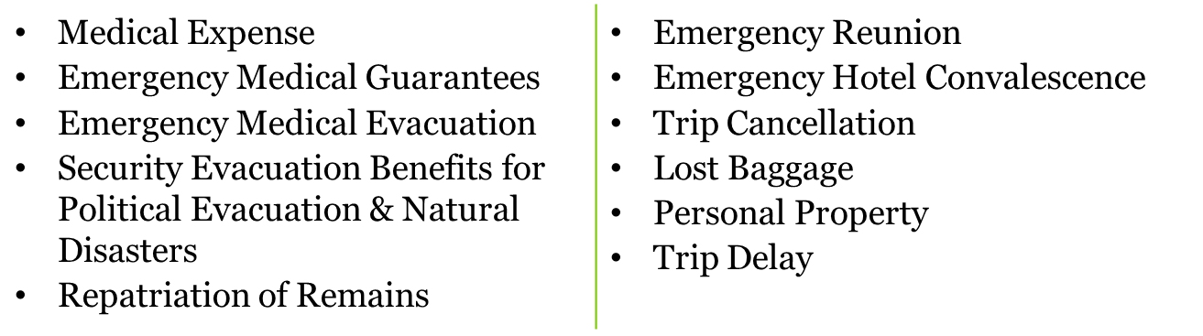
Business Travel Insurance
What’s covered?
  Accident Benefits - AD&D, paralysis, permanent total disability and other related indemnity benefits.
  Out of Country Medical Benefits including emergency medical and trip-related benefits:

Slide 9


Medical (UnitedHealthcare Global)
Serves over 8,000 clients and nearly 20 million individuals in over 150 countries
Serves 169 of the Fortune 500 companies and 61 of the Fortune 100 companies
Most admired healthcare company in Forbes Magazine when rated for ‘global competitiveness’
Offers broad range of capabilities but also provides customized solutions based on UC’s unique needs

Slide 10
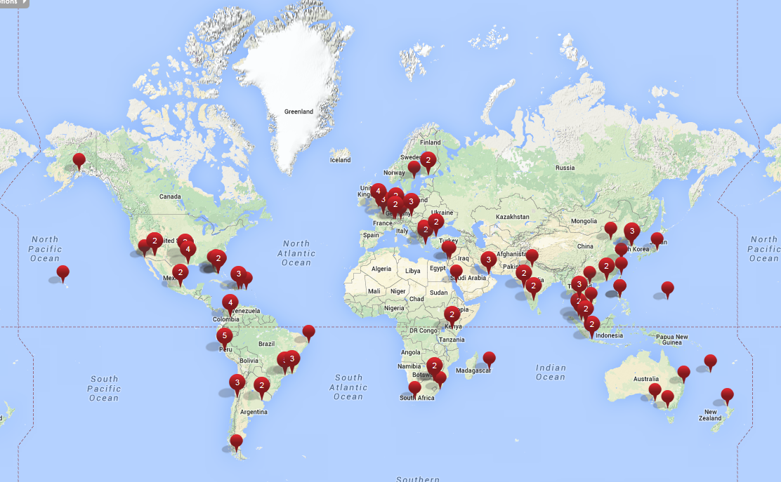
UnitedHealthcare Global - Centers of Excellence

Slide 11

UnitedHealthcare Global - Centers of Excellence
UnitedHealthcare Global has 134 Medical Centers of Excellence around the world.
Centers of Excellence have met UnitedHealthcare Global’s rigorous auditing protocols.
UHG personally visits these hospitals and examines each facility’s procedures, diagnostic equipment, staff training, environmental hygiene, language capabilities, and ability to treat foreign travelers.
The Centers of Excellence have the greatest diagnostic and treatment capabilities in their region.
If a traveler needs to be evacuated for a medical reason, he or she will likely be taken to a Center of Excellence.

Slide 12
University of California
Preparing for Risk

Slide 13
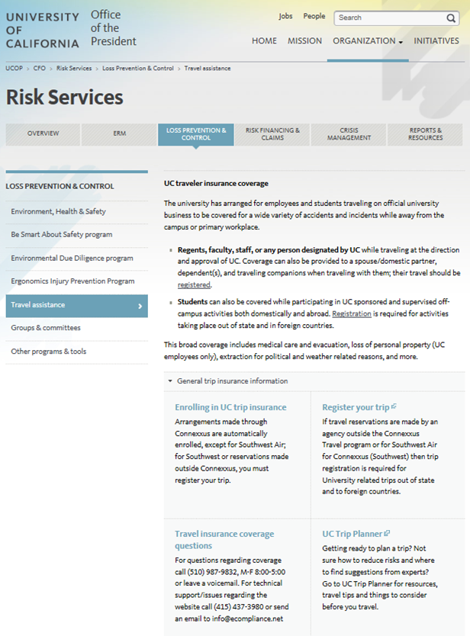
Travel Registration
Enter your trip information and begin receiving iJET Global Alert
updates
http://www.ucop.edu/risk-services/loss-prevention-control/travel-assistance/
Click on Register Your Trip

Slide 14
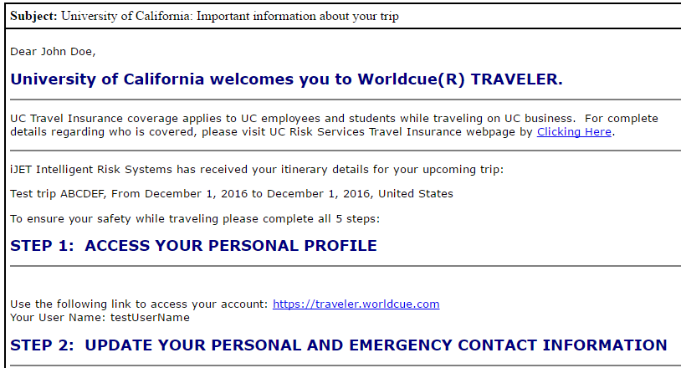
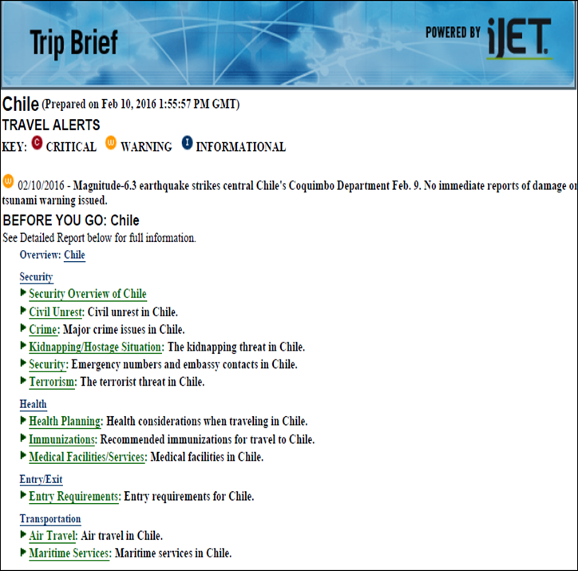
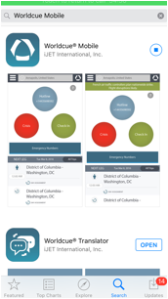
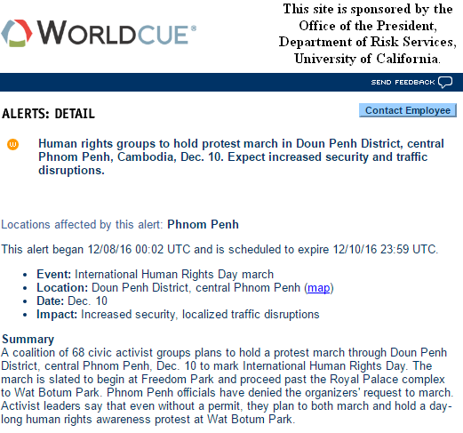
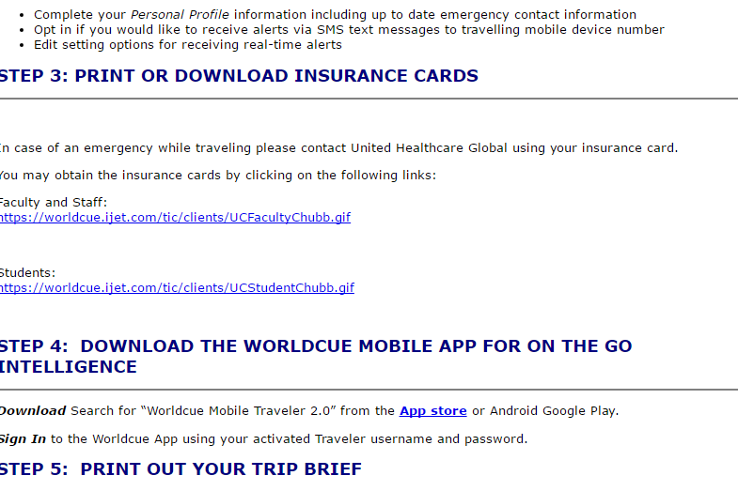
Welcome E-mail
Provides:
  Trip details
  Destination alerts
  Access to trip brief
  Worldcue Traveler and mobile app access
  UC Hotline number

Slide 15
Worldcue® Planner
Access to iJET Intelligence
for all UC Faculty, Staff and Students pre-trip and post-registration
http://www.ucop.edu/risk-services/loss-prevention-control/travel-assistance/
Click on UC Trip Planner and log in with your UC ID and password

Slide 16
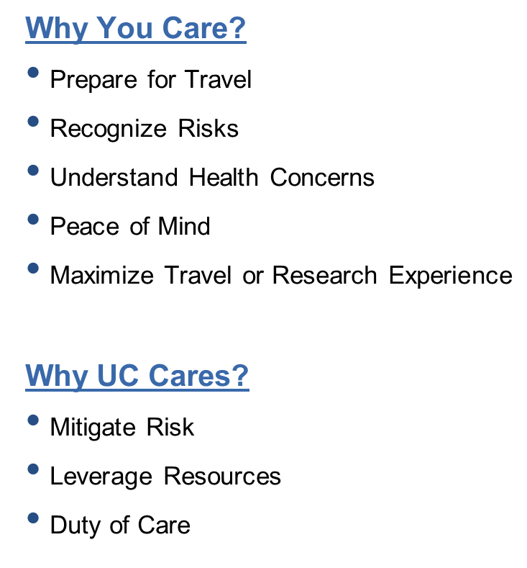
Worldcue® Planner
What Is It?
  Access to Intelligence for all UC Faculty and Students
  Alerts
  Destination Intel
  Country Risk Ratings
  UC Notices by Location
  Location Reports
  Global Travel Advice
  Travel Tools

Slide 17
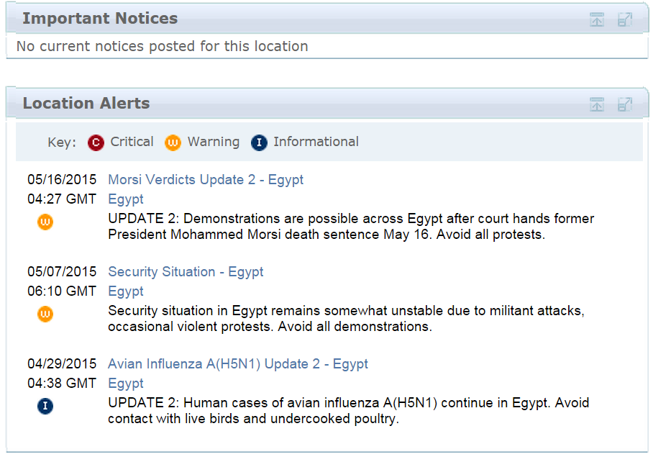
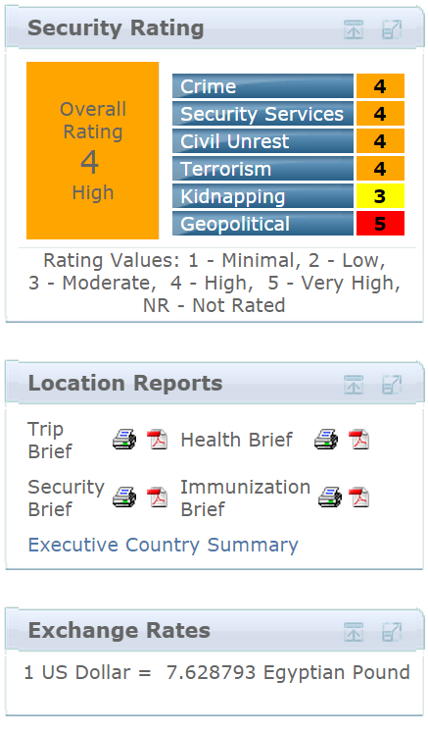
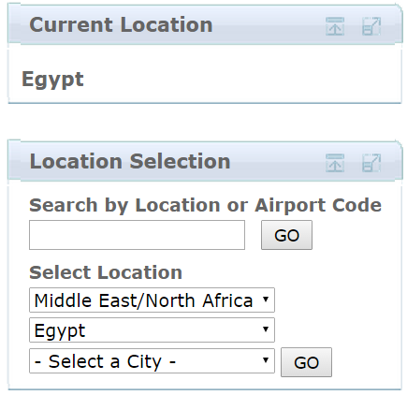
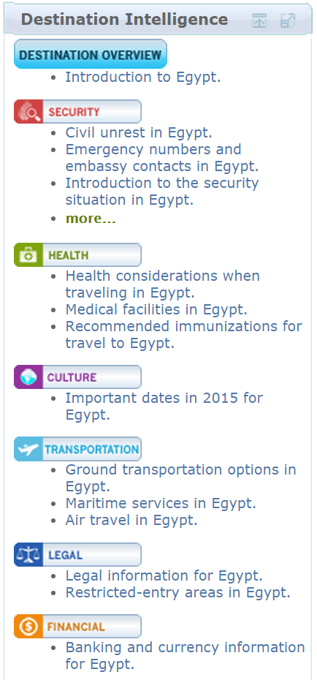
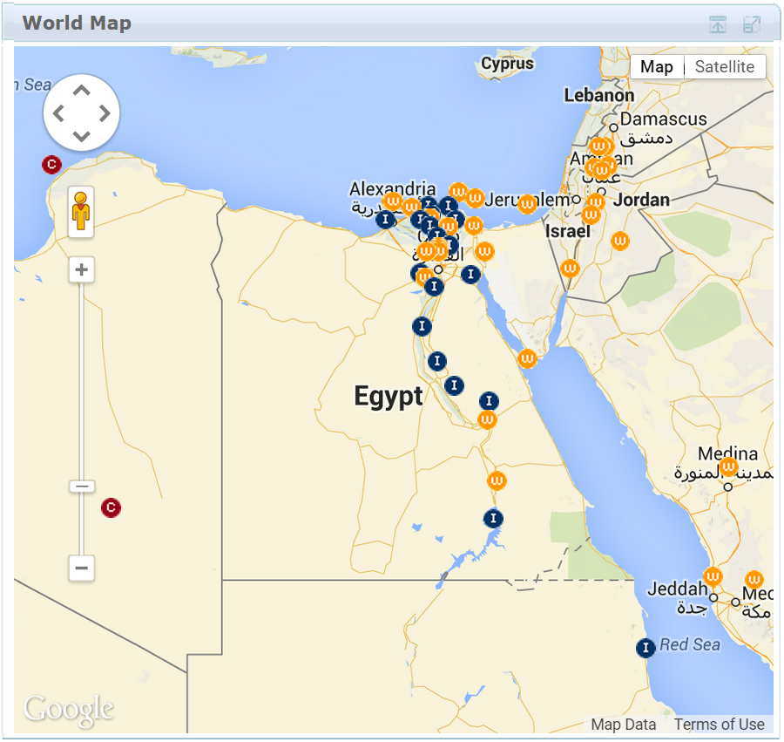
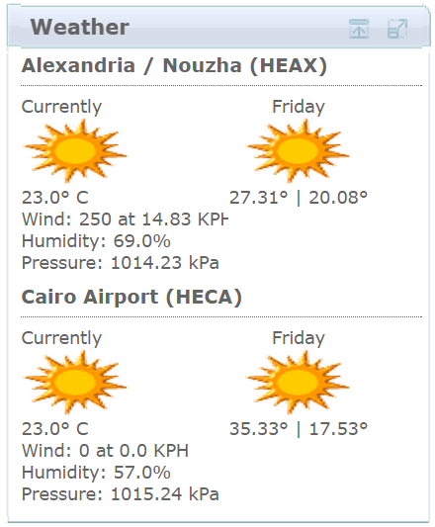
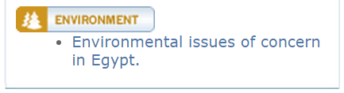
Worldcue® PLANNER – Global Intelligence
  Alerts
  Destination Intel
  Country Risk Ratings
  Location Reports
  Notices by Location
  Global Travel Advice
  Travel Tools

Slide 18
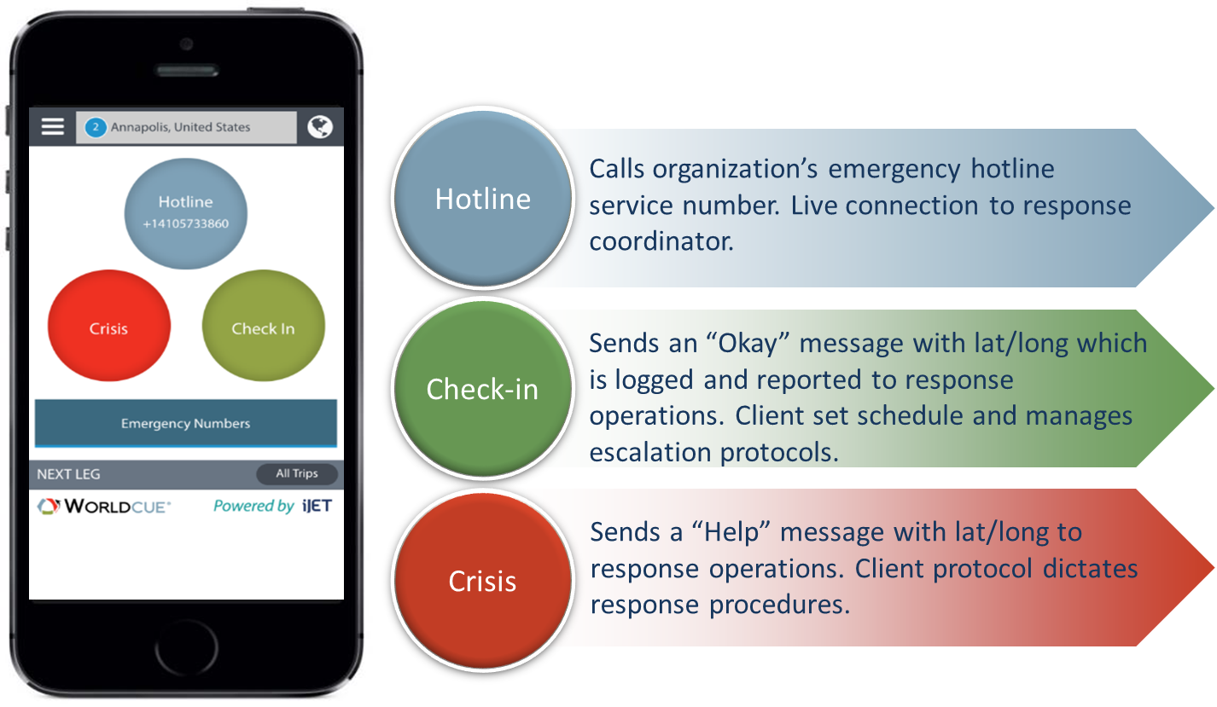
Emergency Communications
Connects traveler to UC’s hotline, answered by a response coordinator
Sends a check-in message with opt in traveler coordinates to campus designated email
Sends “distress” message with opt in traveler coordinates to a campus email.
*Check-in & Crisis quick connect buttons activated at campus level
Notes:
My Profile Tabs (Primary, Traveling and Preferences)
Screenshot 1 - Primary Info Tab - includes the Traveler’s name, company, day-to-day contact info, etc. The user is able to view and edit this information.
Screenshot 2 – Traveling Info Tab - includes the Traveler’s traveling contact information. The user is able to view and edit this contact information.
Screenshot 3 – Preferences Tab – includes alert preferences, share location settings, etc.
Updates made using the Mobile App will appear within the Traveler profile in the Worldcue Traveler web portal.

Slide 19
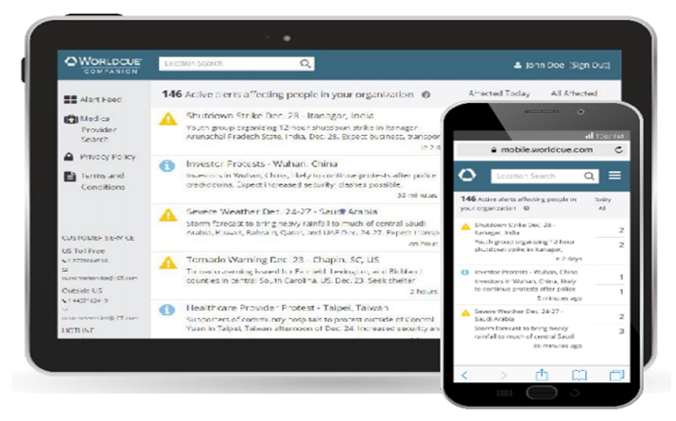
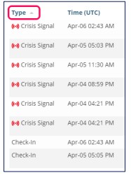
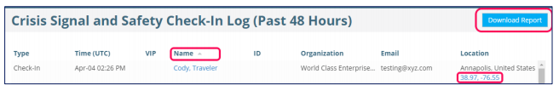
Worldcue Companion Safety Check In & Crisis Signal Visibility
  At-a-glance Alert Feed
  Easy Access to Contact Information
  Communicate with People At Risk
  Access to the UC dedicated Phone Number
  https://mobile.worldcue.com

Slide 20
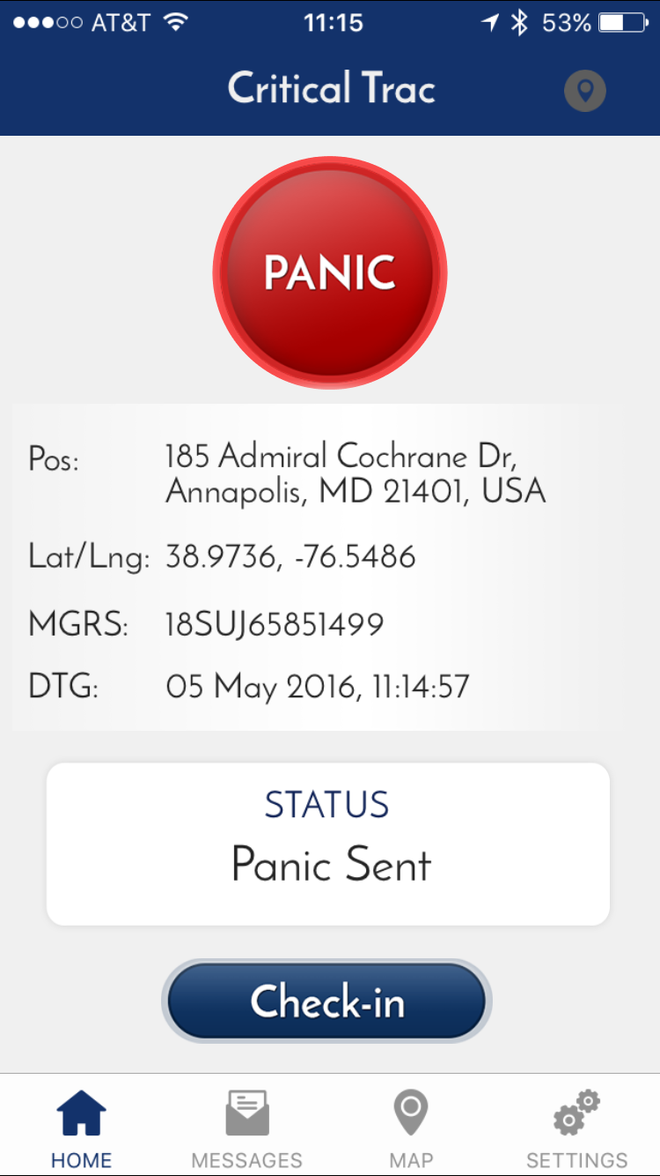
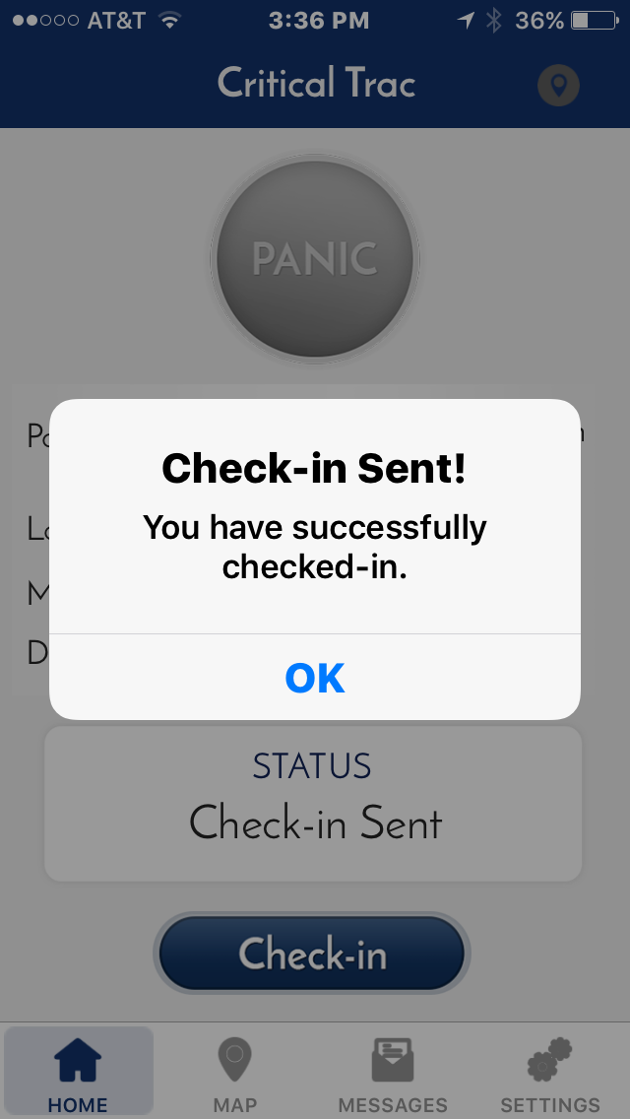
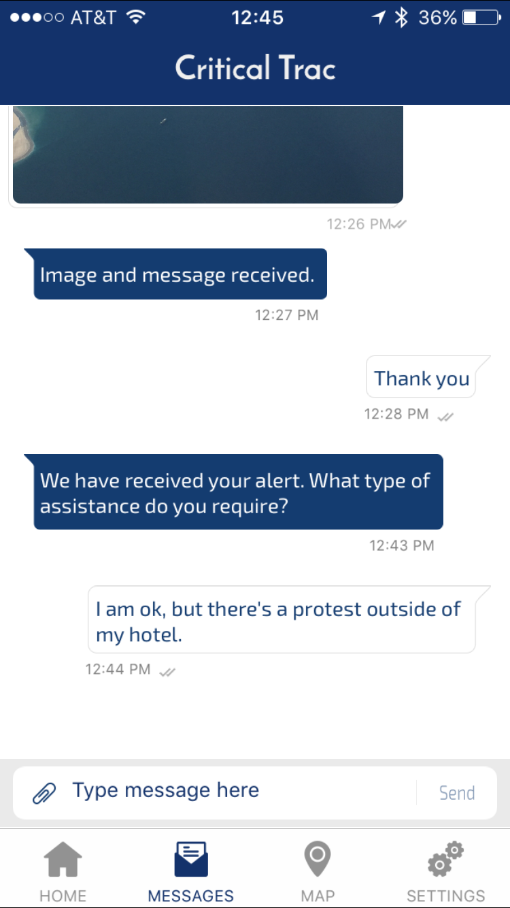
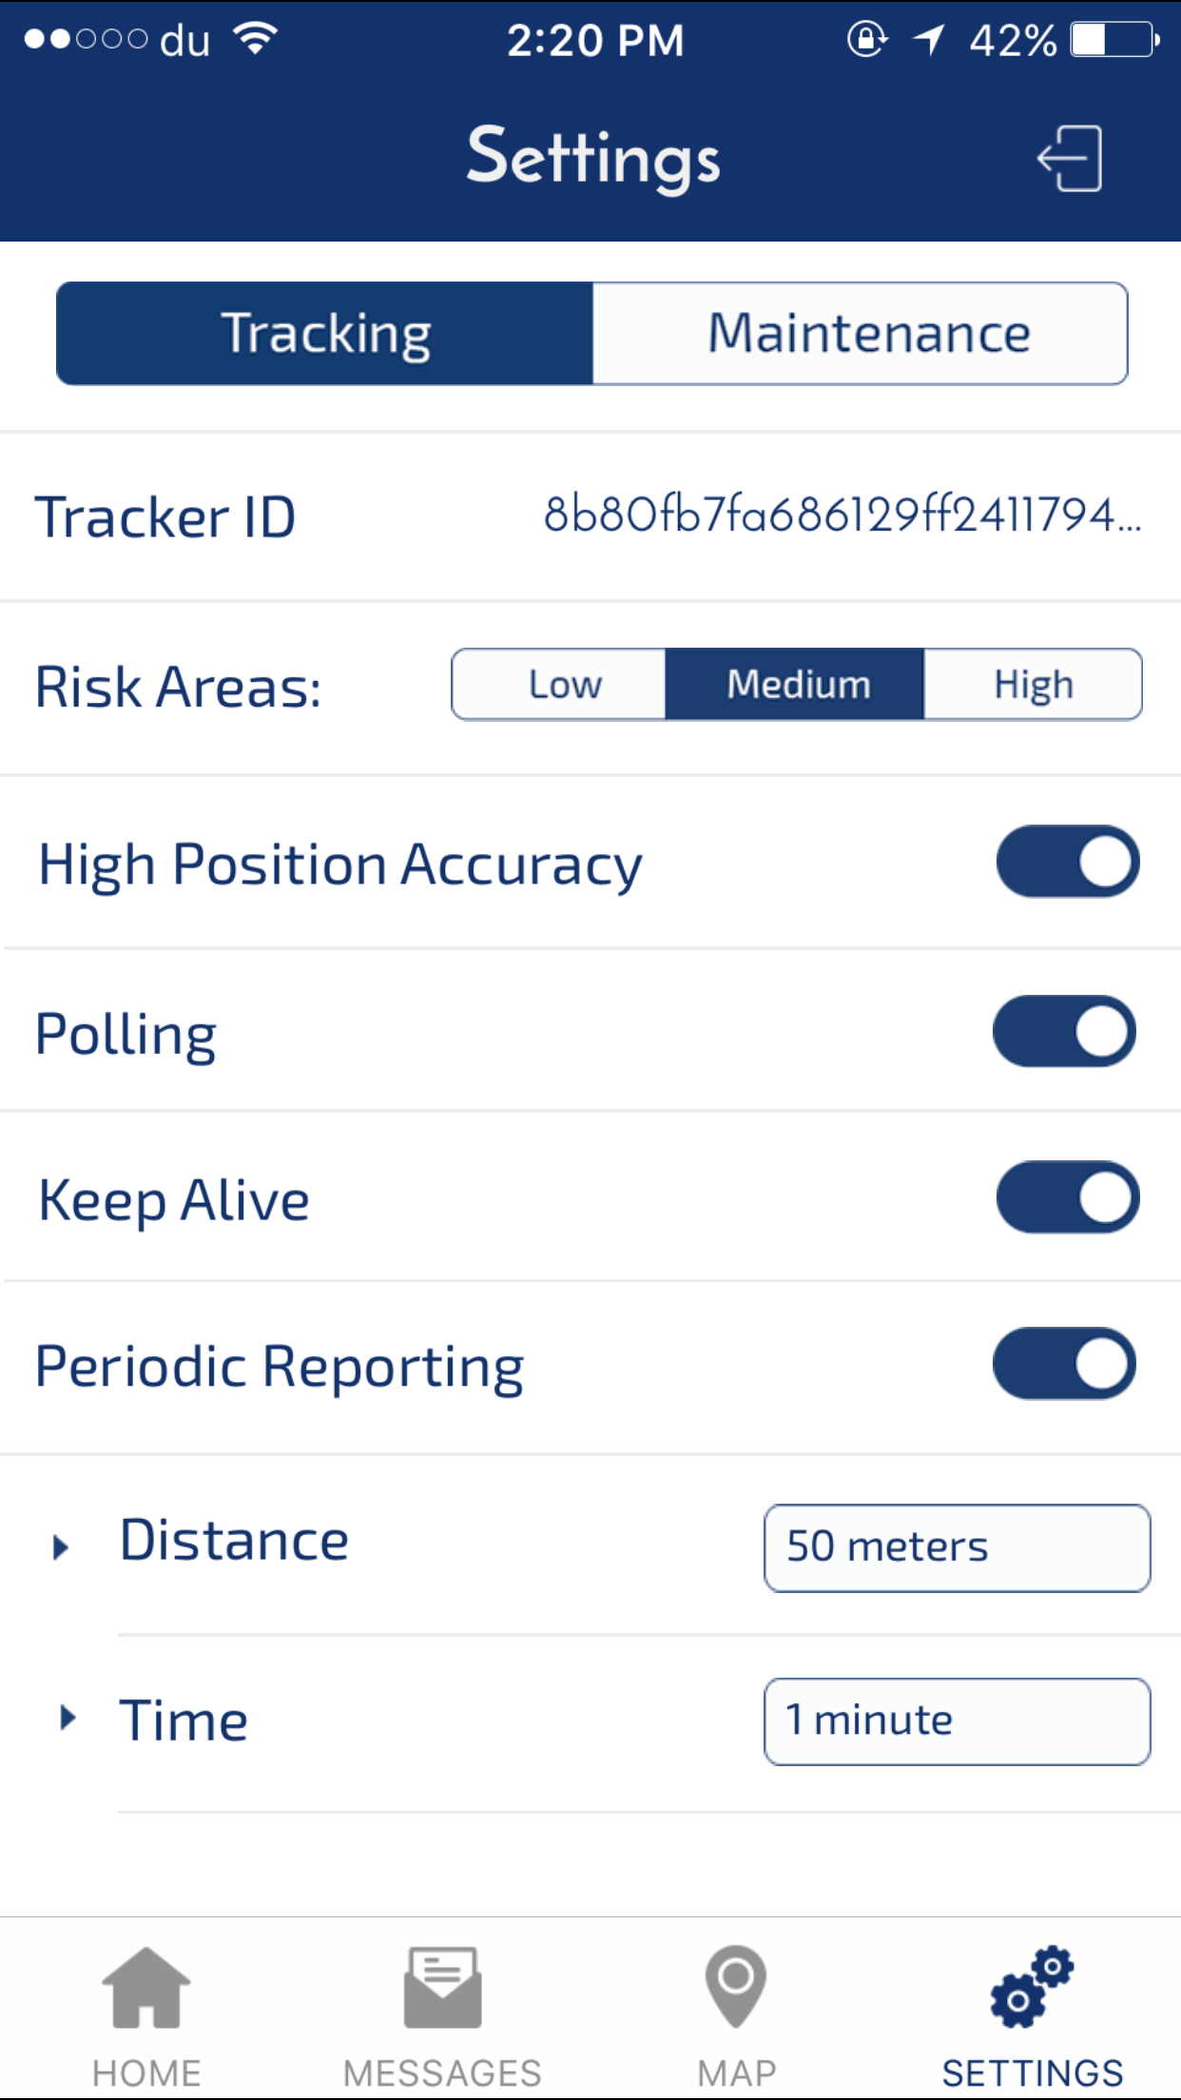
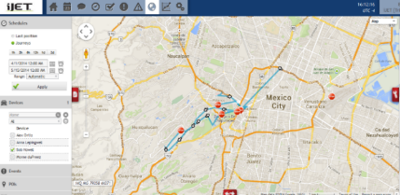
Critical Trac™ GPS Travel Safe Smartphone App
Geo-fencing capabilities
1-button Crisis Alert
1-button Check-in
2-way messaging
Customized protocols

Slide 21
Thank you
Check the Risk Management and Insurance Services website at:
http://rmis.ucsf.edu for information about travel safety and insurance programs, or contact:
Andrew Sinclair, Travel Safety Coordinator Andrew.Sinclair@ucsf.edu

