Slide 1
Academic Senate Telework Survey
Initial Report
July 1, 2020

Slide 2
Background
Faculty work environment and schedule will be adapting to challenges imposed by COVID-19 and related impacts.
Academic Senate requested faculty guidance to shape change management.
A survey was designed by Academic Senate Committees on Space, Academic Planning & Budget, and Faculty Welfare with input from Committees on Equal Opportunity, Clinical Affairs, Research, Rules & Jurisdiction, and the School of Medicine Faculty Council.
Survey distributed via email on June 8, 2020 and closed on June 22, 2020; sent to everybody who has a UCSF faculty appointment (Ladder Rank, In Residence, Clinical X, HS Clinical, Adjunct) including all levels of FTE. 5,202 contacts total.
878 responses recorded (16.9% response rate).

Slide 3
Table of Contents
Demographics
Telework Appropriateness, Interest, and Hurdles
Tax Incentive on Telework
Weekend and Shift Work
Preliminary Observations
Comments

Slide 4
Demographics
Telework Appropriateness, Interest, and Hurdles
Tax Incentive on Telework
Weekend and Shift Work
Preliminary Observations
Comments

Slide 5
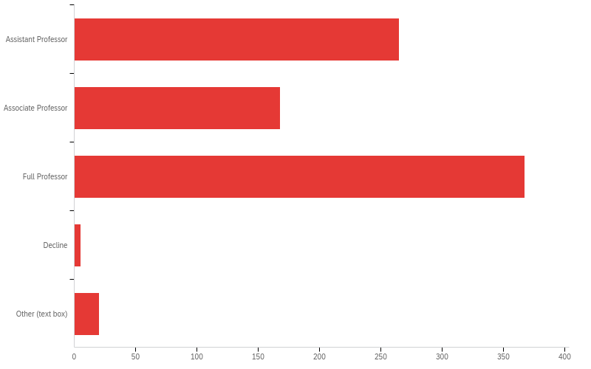
Question 1.1 - Professorial Rank
32.1%
20.4%
44.5%
0.6%
2.4%

Slide 6
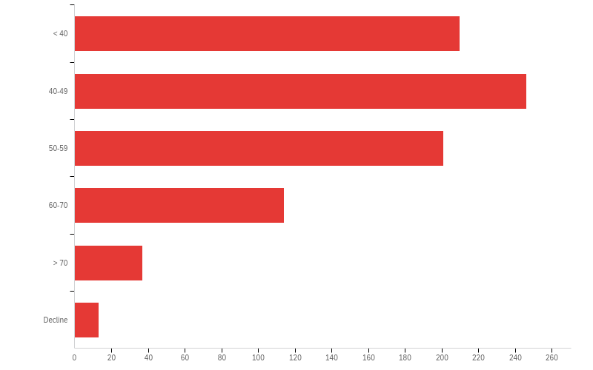
Question 1.2 - Age (years)
25.6%
30.0%
24.5%
13.9%
4.5%
2.4%

Slide 7
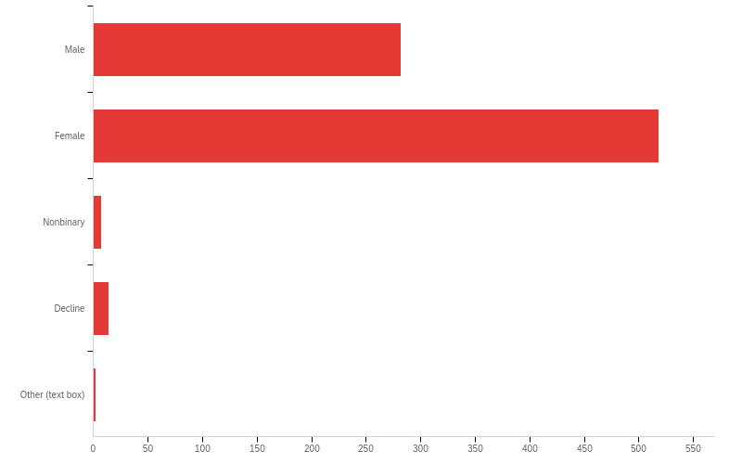
Question 1.3 - Gender
34.3%
62.9%
0.9%
1.7%
0.2%

Slide 8
Question 1.5 - Work Effort Distribution (100% Total)
Work Area | Minimum | Maximum | Mean | Count
Patient Care | 0 | 100 | 29.2 | 839
Research | 0 | 100 | 38.7 | 838
Education | 0 | 100 | 14.6 | 836
Administration | 0 | 100 | 13.4 | 838
Other | 0 | 100 | 1.3 | 833

Slide 9
Demographics
Telework Appropriateness, Interest, and Hurdles
Tax Incentive on Telework
Weekend and Shift Work
Preliminary Observations
Comments

Slide 10
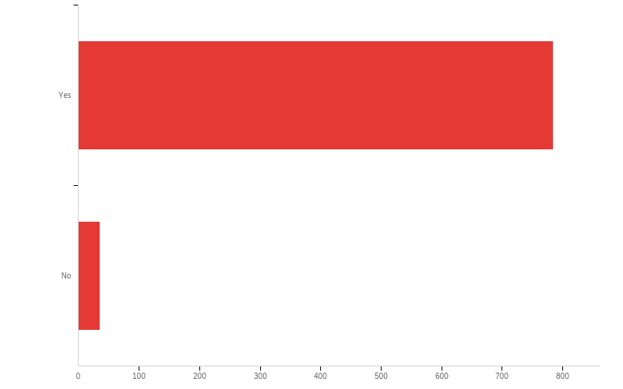
Question 2.1.1 - Do you have enough telework to mostly fill a 4-hour time block, either working alone or with colleagues in a virtual work room?
95.7%
4.3%

Slide 11
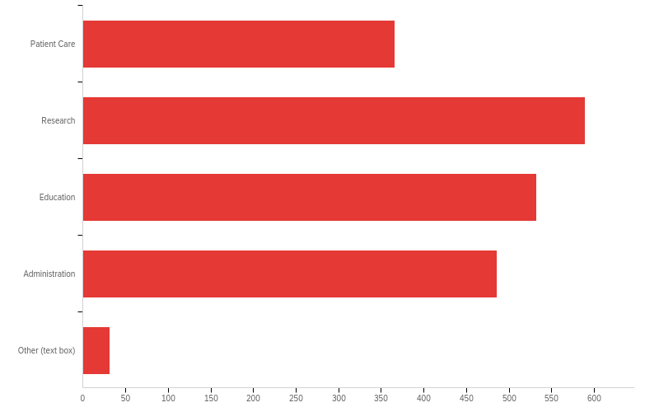
Question 2.1.2 – Work Areas Suitable for Telework:
18.3%
29.4%
26.6%
24.3%
1.6%

Slide 12
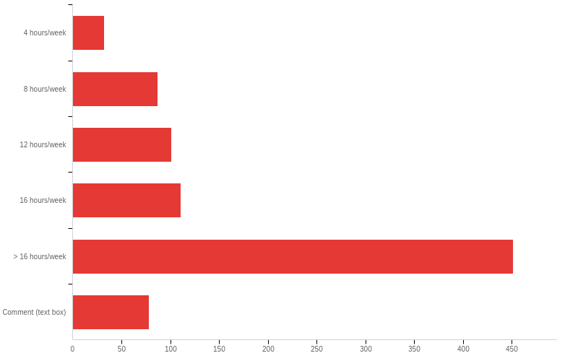
Question 2.1.3 - A single telework time block is 4 hours (1/2 day). How much of your work week would be suitable for telework permanently?
4.1%
11.1%
12.9%
14.2%
57.7%
10.0%

Slide 13
Question 2.1.1 – Responses for ≥ 50% Effort in a Particular Work Area Do you have enough telework to mostly fill a 4-hour time block, either working alone or with colleagues in a virtual work room?
≥ 50% Effort | Yes | No | Count
Clinical | 92.5% | 7.5% | 259/21
Research | 97.8% | 2.2% | 358/8
Education | 95.4% | 4.6% | 62/3
Administration | 96.8% | 3.2% | 61/2

Slide 14
Question 2.1.2 - No, cannot telework for the following reasons (select all that apply):
Reason | Percent | Count
Nature of my work requires physical presence on the UCSF campus at all times | 34.4% | 21
Quality of my work would degrade | 16.4% | 10
My home work space is inadequate | 13.1% | 8
I object to the elimination of a physical boundary between private and professional life | 11.5% | 7
I have direct dependent care responsibilities that conflict with telework | 8.2% | 5
Telework would require unacceptable risk to health and wellbeing such as ergonomic injury and Zoom fatigue | 1.6% | 1
Other (text box) | 14.8% | 9

Slide 15
Question 2.1.3 - My home work space is inadequate (Select all that apply):
Reason | Percent | Count
Ergonomics | 28.6% | 6
Square footage | 23.8% | 5
Privacy | 19.1% | 4
Internet capacity | 9.5% | 2
Noise | 9.5% | 2
Other (text box) | 9.5% | 2

Slide 16
Demographics
Telework Appropriateness, Interest, and Hurdles
Tax Incentive on Telework
Weekend and Shift Work
Preliminary Observations
Comments

Slide 17
Question 2.2.1 - If the tax code were changed to expand the list of deductible items for working at home, would that favorable scenario have any impact on your decision to move more responsibilities to telework?
Answer | Percent | Count
Yes, a favorable tax incentive would encourage me to decrease on campus work permanently | 79.1% | 619
No, despite a tax incentive my telework cannot be increased (i.e., it must return to pre-COVID19 levels or less) | 21.0% | 164

Slide 18
Demographics
Telework Appropriateness, Interest, and Hurdles
Tax Incentive on Telework
Weekend and Shift Work
Preliminary Observations
Comments

Slide 19
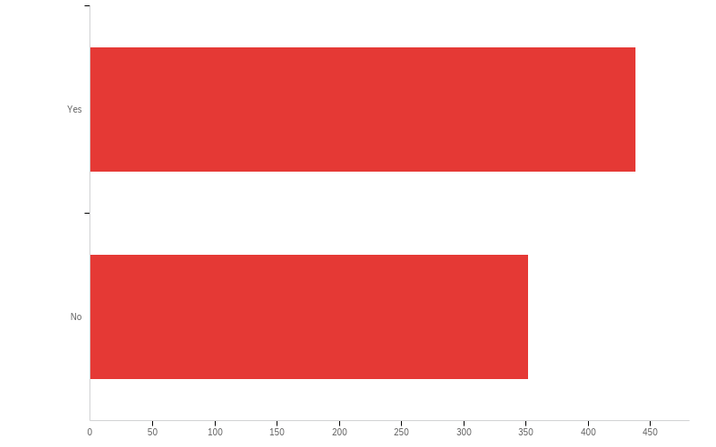
Question 3.1.1 - Do you currently work at least 4 hours or more on either Saturday or Sunday on a regular basis?
55.4%
44.6%

Slide 20
Question 3.1.1 – Responses by Gender
Do you currently work at least 4 hours or more on either Saturday or Sunday on a regular basis?
Gender | Yes | No | Count
Female | 50.4% | 49.6% | 251/247
Male | 64.6% | 35.4% | 177/97
Nonbinary | 90.0% | 10.0% | 9/1

Slide 21
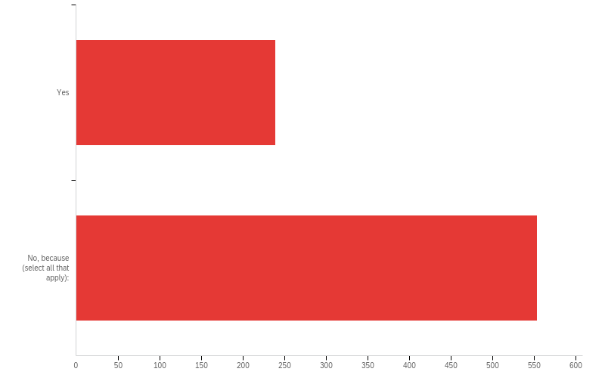
Question 3.2.1 - If Saturday and Sunday were officially incorporated into the regular work week to reduce work environment density and you may choose any other day for compensation, would you consider moving MORE work to the weekend in exchange for a more flexible Monday through Friday schedule?
30.2%
69.8%

Slide 22
Question 3.2.1 – Responses by Gender
If Saturday and Sunday were officially incorporated into the regular work week to reduce work environment density and you may choose any other day for compensation, would you consider moving MORE work to the weekend in exchange for a more flexible Monday through Friday schedule?
Gender | Yes | No | Count
Female | 26.8% | 73.2% | 134/336
Male | 36.9% | 63.1% | 101/173
Nonbinary | 40.0% | 60.0% | 4/6

Slide 23
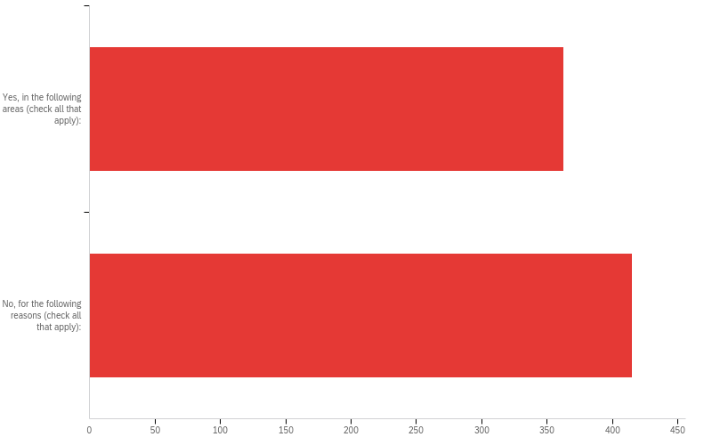
Question 3.3.1 - Shift work may also be considered, but this option may be inappropriate for some or all aspects of your work schedule. Thinking about your professional and personal responsibilities: Are there aspects of your work schedule that could be moved to a shift work model (7AM-1PM, 1PM-7PM; alternating 2-week cycles, etc.) for onsite work?
46.7%
53.3%

Slide 24
Question 3.3.1 – Responses by Gender
Shift work may also be considered, but this option may be inappropriate for some or all aspects of your work schedule. Thinking about your professional and personal responsibilities: Are there aspects of your work schedule that could be moved to a shift work model (7AM-1PM, 1PM-7PM; alternating 2-week cycles, etc.) for onsite work?
Gender | Yes | No | Count
Female | 48.2% | 51.8% | 236/254
Male | 45.34% | 54.6% | 123/148
Nonbinary | 45.4% | 54.6% | 5/6

Slide 25
Question 3.3.2 - Yes, there are aspects of my work schedule that could be moved to a shift work model (7AM-1PM, 1PM-7PM; alternating 2-week cycles, etc.) for onsite work. (check all that apply):
Work Area | Percent | Count
Administration | 25.8% | 199
Education | 24.0% | 185
Patient Care | 22.7% | 175
Dry lab research | 19.7% | 152
Wet lab research | 5.4% | 42
Other (text box) | 2.5% | 19
Total | 100% | 772

Slide 26
Question 3.3.2 - No, aspects of my work schedule could not be moved to a shift work model (7AM-1PM, 1PM-7PM; alternating 2-week cycles, etc.) for onsite work for the following reasons (check all that apply):
Answer | Percent | Count
I do not believe daytime shift work will maintain or enhance quality | 31.0% | 170
I do not have adequate childcare access | 25.2% | 138
I do not have appropriate work for daytime shift work | 25.2% | 138
Other (text box) | 18.6% | 102

Slide 27
Demographics
Telework Appropriateness, Interest, and Hurdles
Tax Incentive on Telework
Weekend and Shift Work
Preliminary Observations
Comments

Slide 28
Preliminary Observations
Telework Appropriateness, Interest, and Hurdles
Appropriate in all work areas for least 4 hours/week
Interest in ≥ 16 hours/week of permanent telework by ~50% respondents
Hurdles include: required or desired campus presence, inadequate home office (ergonomics, space, IT), Zoom fatigue, and childcare
Tax Incentive on Telework
Interest for increased permanent telework in ~80% respondents
No interest reasons include: irreplaceable personal interactions, wet lab activities, monitoring of work productivity, and clinical care financial disincentives

Slide 29
Preliminary Observations
Weekend Work
About 50% respondents work ≥ 4 hours on Saturday or Sunday
In flexible work week schedule scenario, ~30% would increase weekend work
No interest reasons include: need for personal time, saturation of work schedule, unreasonable institutionalized expectation, and childcare
Shift Work
Appropriate in most work areas, except wet lab research, in ~47% respondents
No interest reasons include: concern for work quality, appropriateness, and childcare

Slide 30
Demographics
Telework Appropriateness, Interest, and Hurdles
Tax Incentive on Telework
Weekend and Shift Work
Preliminary Observations
Comments

Slide 31
Question 2.2.1 - If the tax code were changed to expand the list of deductible items for working at home, would that favorable scenario have any impact on your decision to move more responsibilities to telework?
No, despite a tax incentive my telework cannot be increased (i.e., it must return to pre-COVID19 levels or less) because of the following reason(s): (text box)
Patient Care (40 comments total)
The facility fees we charge cannot be made up with telemedicine in its current billing structure. So we are being told that there is not a financially sustainable model for us unless we see patients in person.
Child evaluations that I did in person with a child such as cognitive testing and testing of play and social interactions are hard to measure over telehealth, but our clinic is currently trying to figure out a way to get some of this information from families and telehealth, but it is difficult to gather sensitive information about social interactions over zoom with children.
Patient care is better in person.
Surgery requires you to be there in person.
Clinical responsibilities: The critical importance of communication directly with the clinical team, pathology staff, pathology trainees and the faculty cannot be underestimated. The need to be present to truly communicate with colleagues and staff is best performed in person, including being able to respond in a timely manner to chores such as frozen section or examining patient material on site.

Slide 32
Question 2.2.1 - If the tax code were changed to expand the list of deductible items for working at home, would that favorable scenario have any impact on your decision to move more responsibilities to telework?
No, despite a tax incentive my telework cannot be increased (i.e., it must return to pre-COVID19 levels or less) because of the following reason(s): (text box)
Research (23 comments total)
I have to interact with my lab members face-to-face, help troubleshoot experimental problems in the lab, so I have to come in to work.
Much of my work requires active participation at the laboratory bench.
Most of the work that I perform is interacting with machine used in radiotherapy - this cannot be done offsite (i.e. a car mechanic cannot fix your car by just video chatting with it).
I run a wet lab.
As Program and lab leader need to do part of my work at work location
My laboratory-based research and patient care requires that I work on site.
Most of our research material includes pathology slides, paraffin blocks and gross material that cannot be transported away from the hospital and often requires physically being able to see and select the material for research. In addition, presence of faculty members, fellows, residents and other colleagues creates an environment that will enable quick and efficient feedback and direct communication, which is cumbersome at best when faculty and residents are in cyberspace
My research is done in person and requires specialized equipment. I interact without Human participants, supervise employees and build things.

Slide 33
Question 2.2.1 - If the tax code were changed to expand the list of deductible items for working at home, would that favorable scenario have any impact on your decision to move more responsibilities to telework?
No, despite a tax incentive my telework cannot be increased (i.e., it must return to pre-COVID19 levels or less) because of the following reason(s): (text box)
Education (12 comments total)
I teach 3rd and 4th year dental students clinical periodontology. All of my work is done hands-on with the students in the clinic at the SOD.
Direct supervision of residents and likewise for medical students.
Currently, it is easy for me to almost entirely telework because all my education (including education administration) and service activities take place via Zoom and almost all my clinical work can be done from home as well. However, when that changes back to in-person teaching and clinical service, I will have to return to pre-COVID19 telework levels. (Tax incentives do not have much bearing on the issue for me one way or the other.)
While much of the didactic teaching can be performed online as it could have been prior to COVID-19, assessment and teaching of competencies, skills and behavior are best performed in a physical space where the reactions and behavior of the learners can be monitored easily. Transfer of didactic material and lectures to electronic formats and e-learning partly accelerated due to COVID-19 pandemic has given us a great opportunity to focus more on individual competencies and skills and develop more learner-based strategies to create a better learning environment. There is a huge psychological component to learning and teaching that could not be replicated through the internet, especially when considering education of competencies, professionalism other skills.

Slide 34
Question 2.2.1 - If the tax code were changed to expand the list of deductible items for working at home, would that favorable scenario have any impact on your decision to move more responsibilities to telework?
No, despite a tax incentive my telework cannot be increased (i.e., it must return to pre-COVID19 levels or less) because of the following reason(s): (text box)
Administration (4 comments total)
Work as an administrator.
Telework is limited to administrative duties that require coordination with others and is thus highly limited.
Only administrative work can be done remotely, which is a small percentage of my work.
It doesn't need to return to preCOVID levels, its just hard to have an administrative/leadership role be fully remote.

Slide 35
Question 2.2.1 - If the tax code were changed to expand the list of deductible items for working at home, would that favorable scenario have any impact on your decision to move more responsibilities to telework?
No, despite a tax incentive my telework cannot be increased (i.e., it must return to pre-COVID19 levels or less) because of the following reason(s): (text box)
Barriers and downsides to teleworking (29 comments total)
There is value in being in-person and Zoom is not an enjoyable way to work.
It is also hard to work from home given family and childcare responsibilities.
It is isolating to just be working at home.
I like working in my office - telework blurs the line between work and homelife. I am not interested in telework.
Home situation/setup is not good enough for extended significant home office or telework. Access to office and campus is required.
Zoom presentations are not as crisp and often plagued with technical problems
Finally, I personally do not feel I can be as efficient as I have been on site, and the recent few months with occasional sequestration at home resulted in significant reduction of my productivity and I do not wish to continue that predicament.
Also, from my experience, people cannot be trusted to 'work from home on the honor system' - about 50% of people work about 25% of their effort in these scenarios.
There's no physical place for me to work ergonomically while at home.

Slide 36
Question 2.2.1 - If the tax code were changed to expand the list of deductible items for working at home, would that favorable scenario have any impact on your decision to move more responsibilities to telework?
No, despite a tax incentive my telework cannot be increased (i.e., it must return to pre-COVID19 levels or less) because of the following reason(s): (text box)
Taxes not a factor in decision making (19 comments total)
A tax benefit will not be sufficient for me to buy a house with a separate room in which I can work.
I do not believe the tax incentive would be financially impactful.
The tax incentive is minimal.
The tax incentive is immaterial.
Tax issues are not a variable in my work-from-home equation.
I would not benefit from tax relief, regardless, so this is not a factor. My morale/ mental health and that of my team is a more important factor. I hope the faculty Senate sees this health element as more important than money.
The question was if telework expenses could be deducted, would that influence my decision to do more telework. The answer to that question is no, because I don’t itemize deductions, so the tax incentive means nothing to me.
I don't think changing the tax code will have any impact on the amount of work I would want to do by telework. It isn't that my telework MUST return to pre-covid level, it's just that a tax deduction likely won't change my opinion.

Slide 37
Finished - Thank you for participating in this survey. Please feel free to provide comments below. (text box)
Thank you for participating in this survey. Please feel free to provide comments below. (text box)
In Favor of Telework (23 comments total)
Moving forward, providing more telecommuting options for faculty would be ideal.
Telework greatly reduces much wasted time commuting to UCSF and then back home using public transportation which also significantly helps reduce spread of COVID 19.
I think COVID-19 has demonstrated that there is definitely a place for telework going forward.
I know that office space is an on-going issue at UCSF. I would be happy to explore more flexible office options (ie more use of shared spaces, asynchronously) if this could be traded for long term support of working at home. Commuting is really difficult in the Bay Area. When you combine that with the high cost of living and challenging childcare issues, it makes it difficult for all of us to live in the Bay Area. Continuing meaningful support of working from home would increase quality of life, flexibility and might help make it more feasible for families to stay in the Bay Area. Thanks for your help!
I have no interest in returning to office work unless for essential business until the COVID-19 pandemic has ended. After the pandemic I would love to keep much of my work remote. Commute times and transportation to UCSF are horrendous and a 9-5/shared work space model are not conducive to effective work.
Telehealth is working great.

Slide 38
Finished - Thank you for participating in this survey. Please feel free to provide comments below. (text box)
Thank you for participating in this survey. Please feel free to provide comments below. (text box)
In Favor of Shift and Weekend Work (3 comments total)
We should offer classes on weekends to spread things out!
Night and weekend may be helpful to families.
I would favor working on Sundays in lieu of either Monday or Friday; however my concern is that a current 5 days a week of 60 hours will turn into a 6 days a week for 70 hours.

Slide 39
Finished - Thank you for participating in this survey. Please feel free to provide comments below. (text box)
Thank you for participating in this survey. Please feel free to provide comments below. (text box)
Needs, Support, Compensation, Renumeration (16 comments total)
Need some type of stipend or monetary incentive to be able to set up a healthy, long term work environment at home.
I strongly recommended that UCSF provide its IT team to help set up a higher level of broadband at home and connection between all devices. We have great IT support at work in Mission Hall but 0 at home and I need it to effectively teach and see patients. I would even be willing to pay a % of the home consultation fee.
I would like video editing services being offered so we could record experiments in the lab and have it edited to share with new recruits and collaborators. This will add to the educational part of wet lab research.
Would be good if parking for telecommuters can allow for spurts of in person activity (such as being on service) rather than simply one day a week use
I think there needs to be concerted effort from leadership to have "meeting free" periods during the day -- otherwise, my schedule is full of meetings, and the only time i Have to do actual work is after-hours and on weekends.

Slide 40
Finished - Thank you for participating in this survey. Please feel free to provide comments below. (text box)
Thank you for participating in this survey. Please feel free to provide comments below. (text box)
In Disfavor of Weekend and Telework (9 comments total)
I would strongly disapprove of moving work to the weekends, that is something I do anyway but it should not become an expectation.
Patient video visits are way more exhausting than in person visits.
I would REALLY prefer to go back to in-person. After COVID, if we can't resume having in-person meetings I will be more likely to give up my Admin responsibilities.
Please stop all this Zoom! We need in person teaching! I fear my students are receiving a sub par education! I will retire if we continue with Zoom! I cannot participate in less than exceptional teaching and learning! My students deserve better than Zoom.
I live in a very small SF apartment, which served me well when I worked long hours during the week and hiked on weekends. A table (that functions as a desk) is in my small living room. My work-life is now almost one very long day with little escape from my work. I also didn’t see any questions about quality of life or satisfaction with working in my small apartment and what will it take for me to feel more refreshed in the current scenario, like starting blocks of no email time, more frequent time off, and other adaptations. P.S. Typing in this tiny text box is nearly impenetrable!

Slide 41
Finished - Thank you for participating in this survey. Please feel free to provide comments below. (text box)
Thank you for participating in this survey. Please feel free to provide comments below. (text box)
Types of work: Clinical (7 comments total)
My work is a combination of clinical/patient care in pathology, medical education, administration, and research. Of these, the patient care component is more amenable to being moved to a block model, but preferably on site, as there are some benefits to being in the hospital for tissue analysis and pathology reporting as far as expediting speed of the work.
I wish there was guidance from the med center on reopening outpatient clinics - certainly each clinic needs to have leeway to customize reopening, but having a few more guidelines would be useful (beyond practicing physical distancing and wearing masks). Also, the "standing spots" in elevators are sometimes within 2 feet of each other, which is confusing. Still, I really appreciate all of the efforts being done, including this survey!
Practicing Medicine in general and psychiatry especially should be based on human connection and empathy,not electronic doccumentation and so called time efficiency.
My clinical work cannot be done remotely, but everything else really can be.
I absolutely would be interested in creating more flexible scheduling and telework but feel the clinical responsibilities will limit that transition.

Slide 42
Finished - Thank you for participating in this survey. Please feel free to provide comments below. (text box)
Thank you for participating in this survey. Please feel free to provide comments below. (text box)
Dependent Care (8 comments total)
Changes in work schedule greatly affect parents who are already struggling. It is not just access to childcare, but also children need predictability and a shifting schedule creates chaos in their life.
Remote work depends on childcare situation, e.g. if kids are at school/daycare working from home is more effective than if they are at home with a care provider.
I think the biggest issue for equitable recovery is childcare and space. Currently, I don't have space in my present apartment to work adequately from home and home-school my children.
CHILD CARE IS A CRISIS.
I can’t do any of this without daycare/preschool.

Slide 43
Finished - Thank you for participating in this survey. Please feel free to provide comments below. (text box)
Thank you for participating in this survey. Please feel free to provide comments below. (text box)
Miscellaneous
I am able to work 100% telework, so some of these questions do not apply to my situation.
Reduced days - 4 ten hour days is most desirable to reduce commute times and increase flexibility in this situation.
I don't think the tax treatment is the biggest factor in work from home.
I have a private office so can socially distant while being at work, seems to apply more who have shared work spaces.
I think the ideal balance of home vs office work would be 3 days at home, 2 days in office. Of all my tasks, education would be the most ideal to get back on campus as soon as feasible. I don't think Zoom-based learning is ideal. Most of my research tasks can be done virtually with little consequence to the quality or quantity of work..
The low density in research labs is forcing me to be on campus even more to help people, as I have a dedicated office space I can work in anytime. People can't get help from others in the lab easily because they're all doing shifts.
As a faculty member in the adjunct series, I feel quite confident that the University does not have my back, and will hang me out to dry when I don't "produce" to the level that faculty that have support will do.
I think this survey would have benefitted from commute time info. My commute is 1 hour each way, which is wasted time. telework is much worse, but is offset by not commuting. Also I am taking care of my kids while teleworking, so standard efficiency cannot be expected.

